Slide 1
DOE Neutrino Program Plans
Glen Crawford
Director, Research and Technology R&D
Office of High Energy Physics
Office of Science, U.S. Department of Energy

Slide 2

P5 Neutrino Program Recommendations
Pursue the physics associated with neutrino mass
Several significant changes in direction are
recommended:
  Reformulate the long-baseline neutrino program as
  an internationally designed, coordinated, and funded
  program with Fermilab as host.
  Redirect specific activities and efforts at Fermilab to the PIP-II program of improvements to the accelerator complex, which will provide proton beams with power greater than one megawatt by the time of first operation of the new long-baseline neutrino facility.
Recommendation 12: In collaboration with international partners, develop a coherent short- and long-baseline neutrino program hosted at Fermilab.
  Fermilab has started this process, with our encouragement

Slide 3
P5 Short-Baseline Neutrino Recommendations
Recommendation 15: Select and perform in the short term a set of small-scale short baseline experiments that can conclusively address experimental hints of physics beyond the three-neutrino paradigm. Some of these experiments should use liquid argon to advance the technology and build the international community for LBNF at Fermilab.
  A large fraction of the world’s neutrino program will move to the U.S.
  The worldwide neutrino community will see the U.S. as the place to do their physics

Slide 4
DOE Process for Intermediate Neutrino Program
P5 recommended both:
  LBNF as top midterm priority major project
  A balanced and coherent program of short baseline neutrino experiments including small projects
Plans for LBNF are moving along well and are described in the Fermilab talk immediately preceding
  This talk will focus on the latter, near-term item above
The FNAL short baseline program using the Booster Neutrino Beam is well advanced in planning stages and will be evaluated by the FNAL PAC in January
However, there are many other possible short baseline neutrino experiments using other facilities, with and without accelerator beams
  Many R&D efforts underway at various stages of development
DOE is interested in understanding these various options and plans in more detail
  Community workshop February 4-6, 2015 at Brookhaven
  Followed by a possible call for proposals

Slide 5
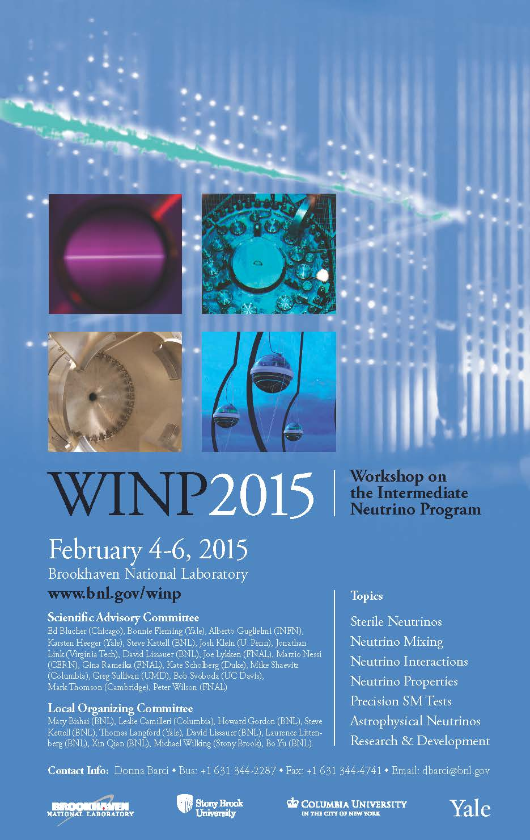
Workshop Info.
Workshop on the Intermediate Neutrino Program
  February 4-6, 2015
  Brookhaven National Laboratory
  www.bnl.gov/winp
Agenda will include:
  Talks from agencies
  Lots of physics working groups on various neutrino topics
Early registration deadline January 9

Slide 6
DOE Process for Short-baseline Neutrinos
Planning for the workshop includes input from NSF and DOE NP as well including PIs supported by those programs
  See www.bnl.gov/winp for more info
The workshop gives us the opportunity, in particular, to hear community ideas for other near term (less than 5 year) small projects (less than ~$10M) that are:
  Scientifically compelling
  Competitive in the world program
  Small enough in scope and technically ready
Based on the information gleaned from the workshop and available funds we may announce a new funding opportunity (FOA) for such small projects later in 2015
  Specific objectives and requirements would be called out in the FOA

Slide 7
Other Elements of DOE Neutrino program
There will be many good ideas that do not fit into the funding or schedule constraints discussed above and we are interested in those, as well
  For example, there are also important issues to address in technology R&D for future experiments and theory support for the broad neutrino program
  Reports from the working groups will be helpful in addressing these issues
Possible funding for such efforts will be dealt with through the usual proposal process. There may be additional opportunities for partnerships or other collaborative funding.

Slide 8
Backup

Slide 9
Measuring Neutrino Properties
Neutrinos are neutral and only interact via the weak force
  Experiments need to generate a huge number of neutrinos
    Nuclear power plants produce antineutrinos in all directions
    Powerful accelerators can produce copious amounts of neutrinos and antineutrinos in a directed beam to a neutrino detector
  Experiments need very large and sensitive detectors
    Hundreds to thousands of tons of mass help allow a neutrino interaction
    High detector sensitivity helps record rare interactions, when they occur
Neutrinos are known to change types as they travel and it is not clear if there is a difference in the way neutrinos and antineutrinos interact
  It takes some time (distance) for neutrinos to change types (oscillate)
    Optimal distance depends on the properties of the neutrino source
    Some measurements require hundreds of miles between source and detector
  Accelerators required to study difference between neutrino & antineutrino
Understanding the complex physics of neutrinos requires a complementary set of experiments with different sources and detectors

