Slide 1

Laboratory Directed Research and Development (LDRD) Review by ASCAC*
Dawn Bonnell
based on Martin Berzins’ earlier presentations.
Overview of LDRD
Committee Charge
Committee Composition
Review Process
* On behalf of and with BERAC, BESAC, FESAC, HEPAP, NSAC, DPAC EMB and NEAC

Slide 2

LDRD Projects Overview
LDRD projects are required to be :
Relevant to DOE/NNSA, Medium term (<36 Months) and “small”
Must include one or more of
Advanced study of hypotheses, concepts, or innovative approaches to scientific or technical problems;
Experiments and analyses directed towards “proof of principle” or early determination of the utility of new scientific ideas, technical concepts, or devices or
Conception and preliminary technical analyses of experimental facilities or devices.
Source DOE Reports to Congress 2005 to 2015

Slide 3
LDRD Historical Background
Funding for the LDRD like activities goes back to Atomic Energy act of 1954
In 1985 DOE established Exploratory Research and Development Program
In 1991 this became Laboratory Directed Research and Development Program, with funding limited to 6% of the funds available to DOE
In 2006 the 6% limit was increased to 8%
In 2014 the Energy and Water Appropriations act reduced the 8% limit back to 6%. Current spend is about $540M
LDRD Funding is accumulated as part of the overhead charged by individual labs
Source DOE Reports to Congress 2005 to 2015

Slide 4
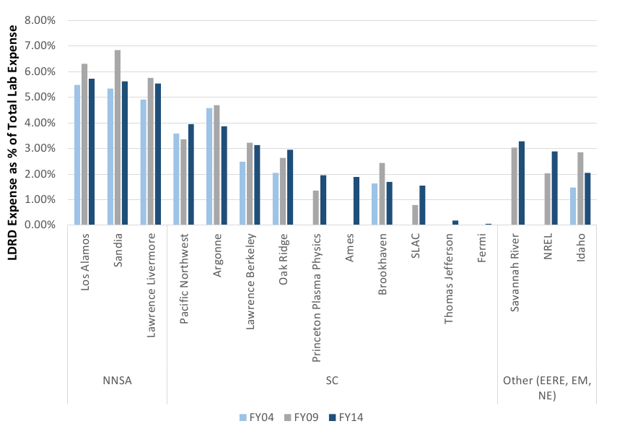
DOE Lab LDRD Percentage Funding
SOURCE Commission to Review Effectiveness of National Energy Laboratories
Report Vol. 2
NNSA | SC | OTHER

Slide 5
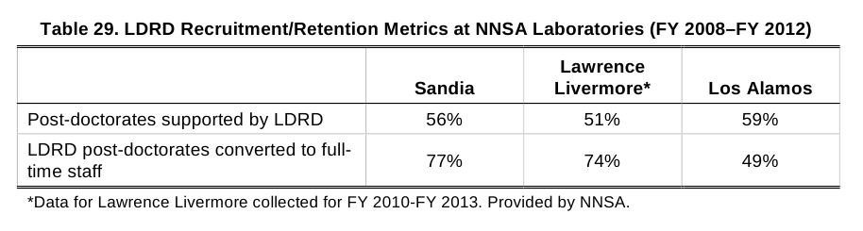
Overview of LDRD Projects
There are approximately 1700 projects per year
The average spend is $300k per project with some variations
About 2000 papers and 400 inventions per year result.
About 650 (2005) to 900 (2015) postdocs fully or partially supported
On average ~30% of all lab post-docs fully or partially supported
Higher percentages of postdocs supported at LBNL, LLNL and SNL
Majority of LDRD projects include early career researchers
Source DOE Reports to Congress 2005 to 2015

Slide 6
Committee Charge
The June 17, 2015, the interim report of the Secretary of Energy Advisory Board (SEAB)Task Force on DOE National Laboratories recommended an independent peer review of the LDRD program impacts and process of four laboratories, evaluating up to ten years of funded projects.
ASCAC is asked to review the LDRD program processes and the impact of LDRD at four of the DOE Labs, to include at least one SC Lab, one NNSA Lab, and one of the applied energy Labs.
Please choose Labs that have had LDRD programs for at least ten years.
ASCAC should consider each Lab's processes to:
(i) determine the funding levels for the LDRD programs;
(ii) determine Lab-specific goals and allocate resources among the goals;
(iii) select specific projects; and
(iv) evaluate the success and impact of the LDRD program against Lab-specific goals and the overall objectives of the LDRD program over a ten-year period.

Slide 7
Committee Membership Formation
Professors Dan Reed and Martin Berzins asked for committee nominations from the chairs of
Basic Energy Sciences Advisory Committee (BESAC))
Biological and Environmental Research Advisory Committee (BERAC)
Fusion Energy Sciences Advisory Committee (FESAC)
High Energy Physics Advisory Panel (HEPAP)
Nuclear Science Advisory Committee (NSAC)
Defense Programs Advisory Committee (DPAC)
Environmental Management Board (EMB)
Everyone nominated accepted.

Slide 8
Committee Membership
ASCAC Tony Hey ( STFC, UK & UW) and Martin Berzins (Utah) (Chair)
BESAC Dawn Bonnell (Penn)
BERAC Karin Remington (CTO Arjuna Solutions)
FESAC Chris Keane (WSU)
HEPAP and NSAC Karsten Heeger (Yale)
DPAC Jolie Cizewski (Rutgers)
NEAC Joy Rempe ( Rempe and Associates)
EMB Beverly Ramsey (Desert Research Institute)

Slide 9
Committee Process
Discuss how best to address the committee charge using available information (including lab self-assessment already in place) and the lab visits
Formulate a detailed set of questions for the four labs based on the committee charge regarding:
(i) Processes for determining the funding levels for the LDRD programs;
(ii) Processes for determining Lab-specific goals and allocating resources among the goals;
(iii) Processes for selecting specific projects; and
(iv) Processes for evaluating the success and impact of the LDRD program against Lab-specific goals and the overall objectives of the LDRD program over a ten-year period.

Slide 10
Committee Lab Visits
Committee charge request visits to four labs including one SC lab, one NNSA lab and one applied energy lab. All the labs should have had LDRD activities for a decade.
Based on this charge we conducted four visits

Slide 11

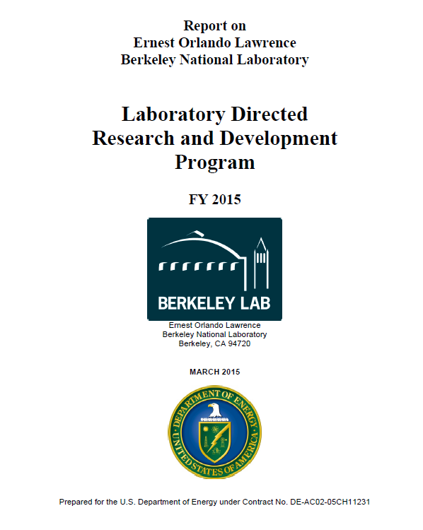
January 4, 1017

Slide 12


January 5-6, 2017

Slide 13

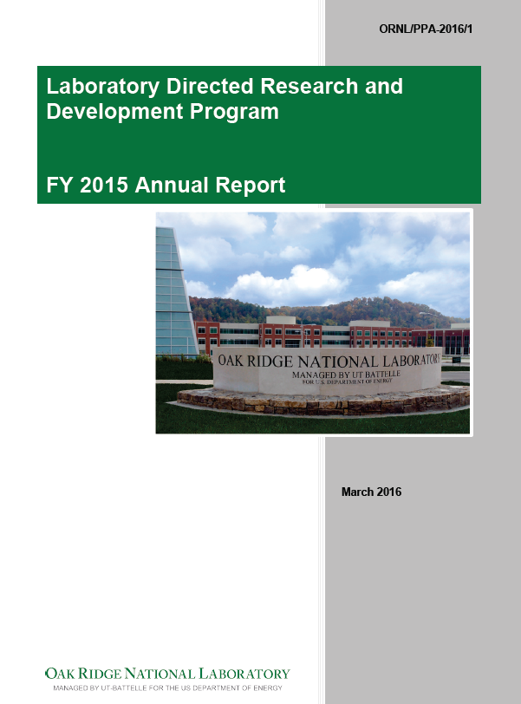
January 26, 2017

Slide 14


February 2, 2017

Slide 15
Timeline
September to November 2016 - teleconferences to formulate implementation of committee charge and timing and format of lab visits
December 2016 to February 2017 Lab visits
Mid January 2017 to early March 2017 report drafting
March/April 2017 Comment period on Initial Report
April/May Final Report

Slide 16




