Slide 1
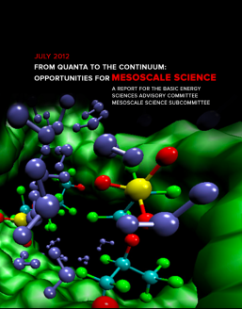
Quanta to the Continuum:
Opportunities for Mesoscale Science
John Sarrao
George Crabtree
BESAC, July 2012
As always, thanks for a valuable and fruitful discussion
meso2012.com

Slide 2
Path forward
Clean up editorial issues/figures/etc. (good overall edit)
Input/scribbling from BESAC members (asap) appreciated
Scrub PRDs (esp. #4-6) re: bio and quantum concerns
Engage Jack, Laura on those gaps
Enhance cross cutting themes/future capabilities/workforce development discussion
Subcommittee to work
Improve/tighten exec summary & intro, including images/sidebars
Subcommittee to work
Write “few pager” on broader messaging*
*“Starting from the end;” continue to engage Bill in the dialogue
Develop outreach plan w/elevator(s), especially including industry
Look to BESAC (e.g., Simon, Roger, Ernie, Mark, Frank & others for contacts)
…by the end of august

Slide 3
A possible logic for broader message
Imagine…
The ability to manufacture predictively at the mesoscale … yielding faster, cheaper, higher performing, and longer lasting products.
Imagine…
exploiting biologically inspired complexity and functionality … to transform energy conversion, transmission, and storage with earth abundant materials
Imagine…
transforming how we create functionality by design from the top-down AND the bottom up simultaneously … to produce next-generation technological innovation.
The opportunity to realize this vision exists at the mesoscale:
Harnessing mesoscale structure, dynamics and interactions to create controlled functionality
New capabilities are within our reach to discover principles and enable solutions:
Directed assembly, in situ dynamics, and predictive multi-modal function
3

