Slide 1
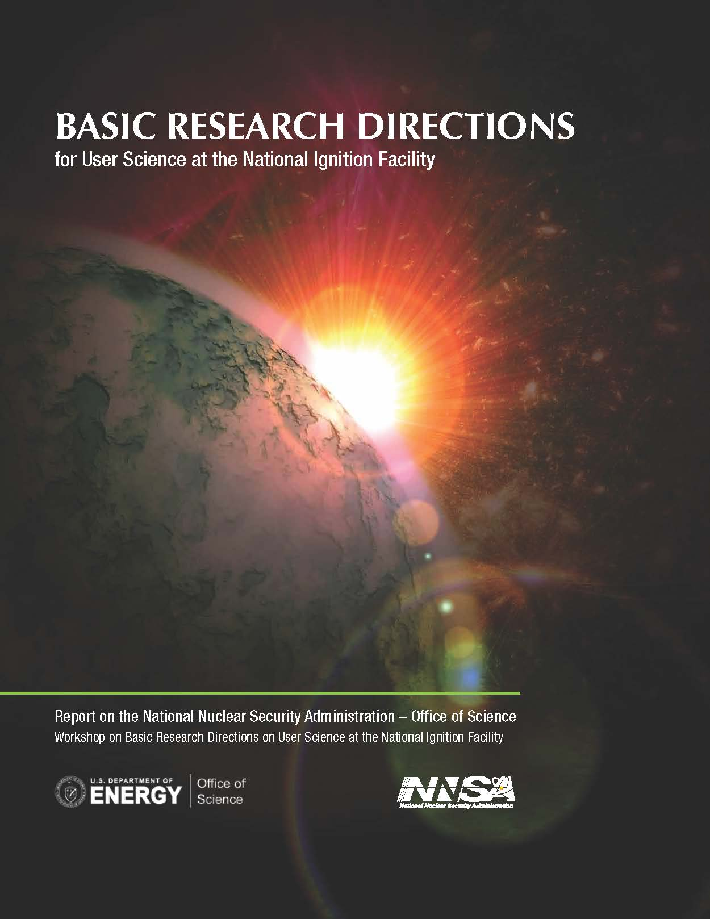
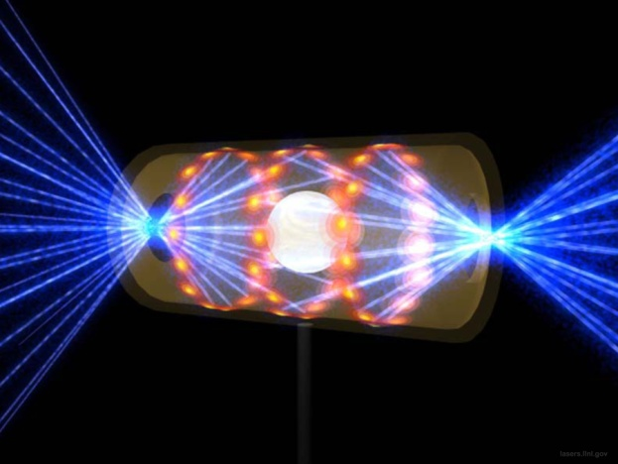
“Basic Research Directions Workshop on User Science at the National Ignition Facility” – An NNSA/SC Workshop
John Sarrao
Basic Research Directions Workshop on User Science
at the National Ignition Facility

Slide 2
Extreme Energy Environments
Ultrasupercritical
combustion boilers
Fuel cells and battery systems
Fast-spectrum nuclear reactors, fusion systems
Chemical reactivity
Solar thermal concentrating towers
Displacive radiation,
> 100 dpa
Temperature
> 1200ºC
Extreme Environments
for Materials
Lightning surge arrestors,
power grid
Static
pressure > 30 MPa
Electric pulse,
2 x 10⁵ A in
< 5 μs
Hydrogen pipelines
Magnetic fields > 15 T
Cyclic stresses,
5 x 10⁸ cycles
Synthesis of advanced materials
Wind turbine blades
Notes:
Examples of extreme environments, showing how pervasive they are in energy applications. It is often the extreme environment that limits the performance of energy technologies. Higher efficiencies require higher temperature, and often other extremes as well, such as pressure in boilers, turbines and engines, chemical corrosion of water and the solutes it contains, and high particle or photon fluxes.

Slide 3
Thermomechanical Challenges
Characterize high static and dynamic pressure phases
In situ experiments at BES x-ray, neutron and electron scattering and NNSA high energy facilities
Time evolution of structural phase transitions and role of defects
Chemical reaction dynamics of high energy materials
High pressure response of disordered materials
Raise the limits of high pressure static and dynamic generation
Notes:
Discovery of two phases of amorphous ice, produced by phase transition from crystalline phases, suggests that disordered materials have interesting properties at high pressure. polymers, glasses,semi-crystalline materials need to be studied.

Slide 4
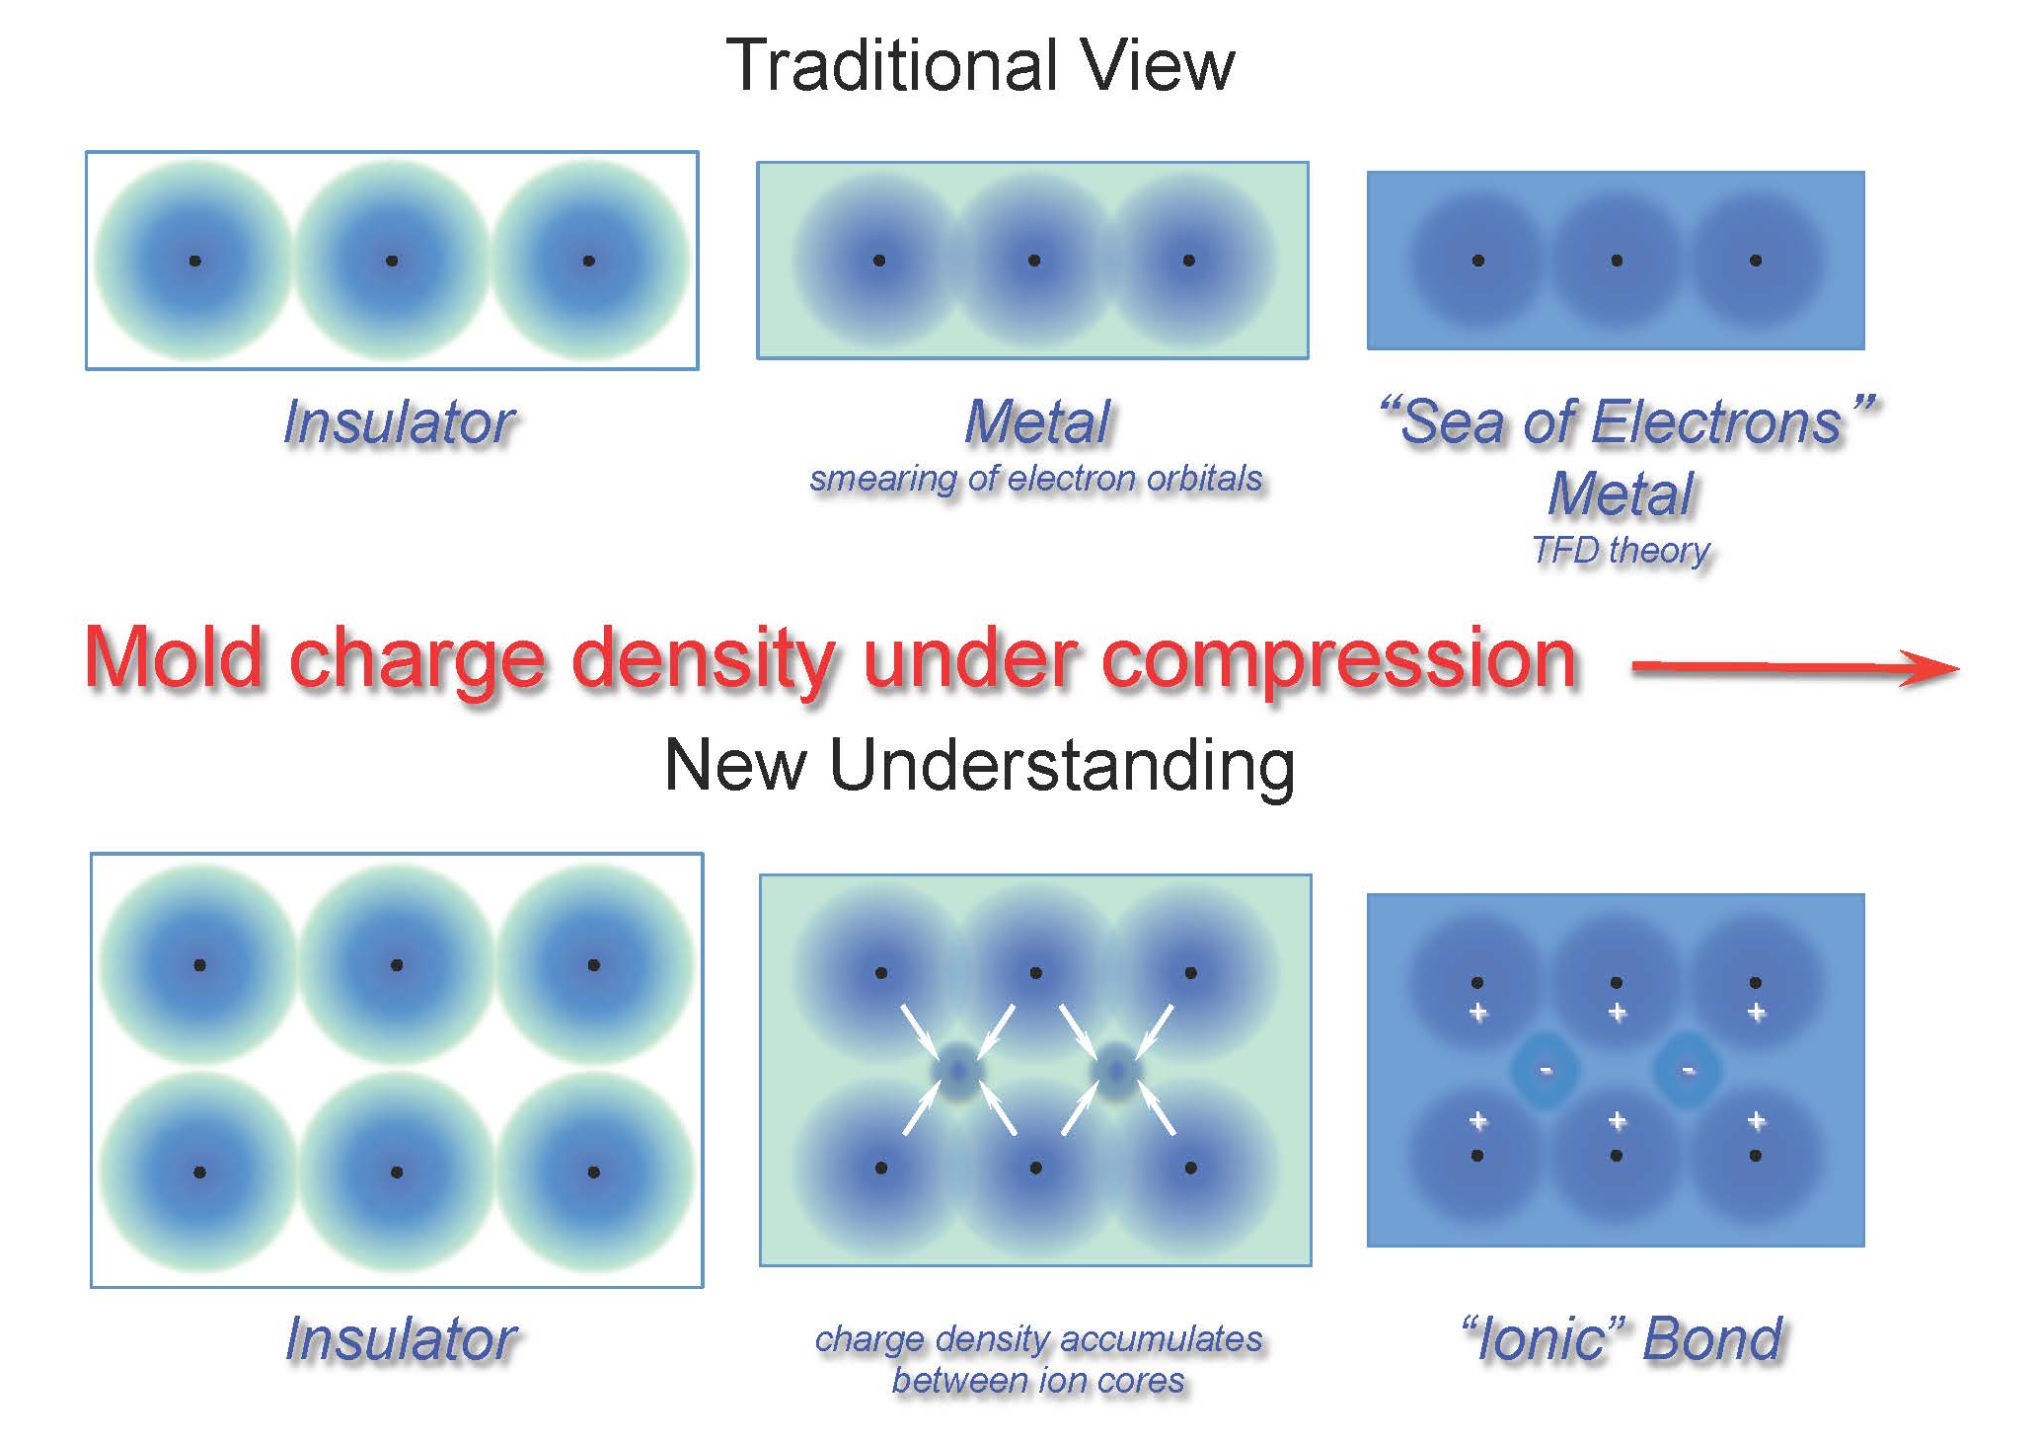
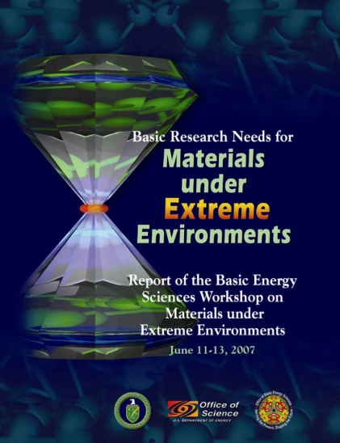
Materials at Extremes and Planetary Physics
Paradigm in structures and bonding has been overtuned (Mbar)
e²
2a₀⁴
NIF will enable studies of
materials at atomic pressures
= 147 Mbar
ATOMIC
PRESSURES

Slide 5
NIF: A precision instrument for the exploration of matter at extreme conditions

Slide 6
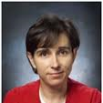
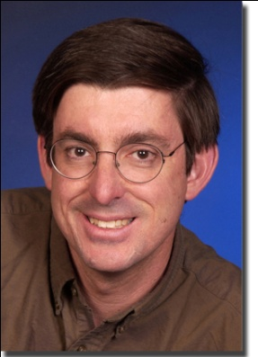
“NIF Science” Workshop
May 9-12, 2011
Panel Chairs:
Laboratory Astrophysics:
Paul Drake (Michigan)
Nuclear Physics:
Bill Goldstein (LLNL), Rich Petrasso (MIT), Michael Wiescher (Notre Dame)
Materials in Extremes & Planetary Physics:
Rus Hemley (Carnegie)
Beams & Plasma Physics:
Chan Joshi (UCLA), Warren Mori (UCLA), Margaret Murnane (Boulder), Alan Wootton
Cross-Cut/Facility User Issues:
Roger Falcone (Berkeley)
Workshop Chairs:
Kim Budil, LLNL
John Sarrao, LANL
Michael Wiescher, Notre Dame
Plenary Speakers:
Bill Brinkman, Don Cook, Steve Koonin
Chris Keane
Patricia Dehmer, Ralph Schneider
Jim Glownia, Office of Science
Mike Kreisler, NNSA
Basic Research Directions Workshop on User Science
at the National Ignition Facility

Slide 7
Workshop Goals
Summarize key aspects of the current state of scientific research and understanding in relevant fields;
Define a set of related Science Grand Challenges;
Identify a set of Proposed Research Directions that address broad scientific uses of the NIF; and
Provide a preferred facility governance process, including responsibilities of key individuals, the process for user access and allocation of NIF facility time and resources, and other policies and procedures relevant to facility users;
Basic Research Directions Workshop on User Science
at the National Ignition Facility

Slide 8
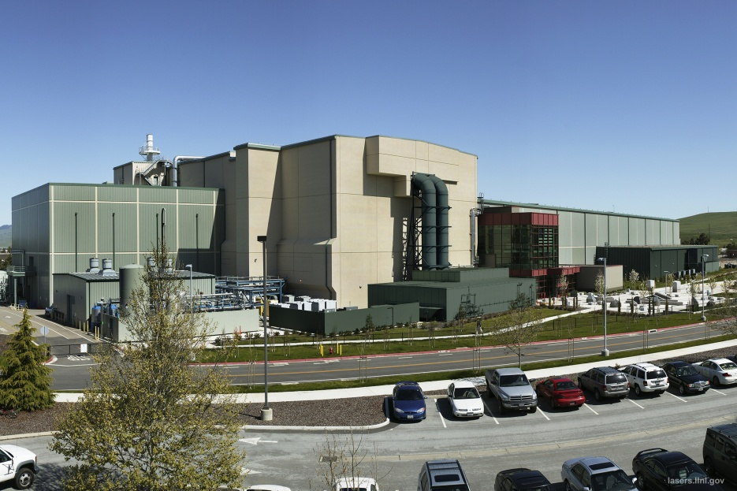
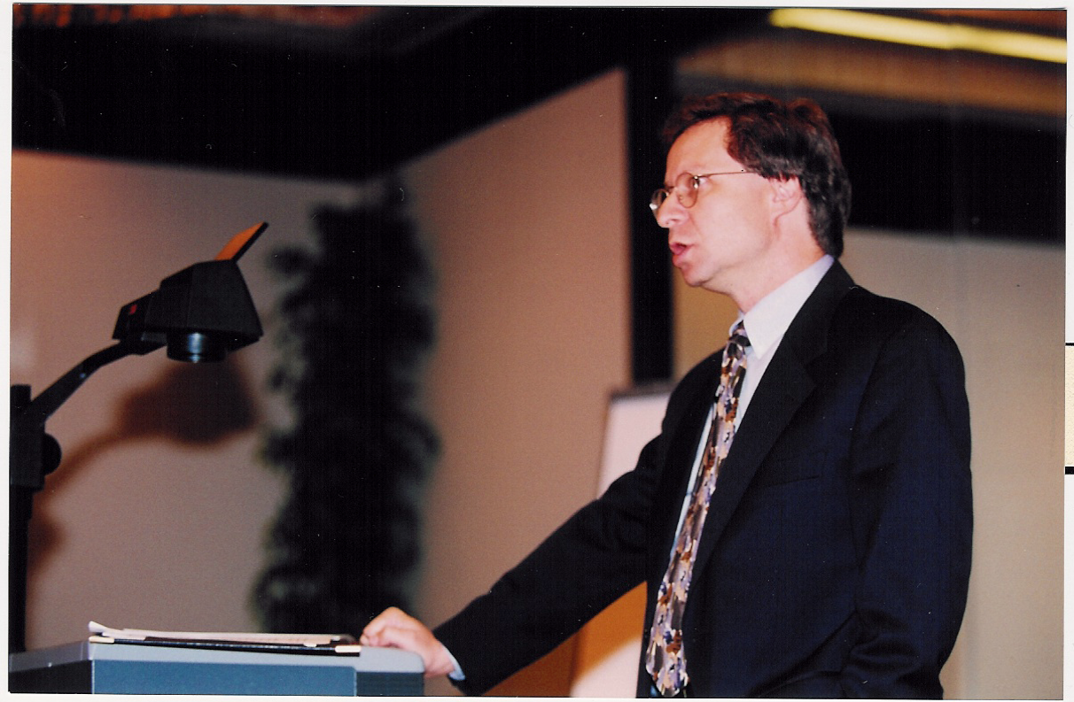
Consider an exciting new facility … and remember the past
Unprecedented environment for science
• Matter temperatures exceeding 10⁸ K;
• Densities of ~ 10³ g/cm³;
• Pressures greater than 10¹¹ atmospheres;
• Radiation temperatures exceeding 10⁶ K;
• Neutron densities as high as 10²⁶/cm³.
“Foremost among my credentials for undertaking this task are that I’m trained as a theoretical physicist, which gives me license to poke my nose into anybody’s business. “10/4/99
Basic Research Directions Workshop on User Science
at the National Ignition Facility

Slide 9
Gather ~100 people from ~49 institutions in 6 countries to
Define discipline-specific challenges (The Problem)
that NIF can address (The Solution)
on a decadal scale (The Path to Success)
that will make a difference for science (The Impact)
In Laboratory Astrophysics, Nuclear Physics, Materials and Planetary Physics,
and Beam and Plasma Physics
Basic Research Directions Workshop on User Science
at the National Ignition Facility

Slide 10
Title of Panel
Title of Priority Research Direction
Discipline Specific Challenge
NIF enabled Innovation
Decadal-scale “grand challenge”
“Big idea” realized by new capability
What new tools/techniques/platforms/diagnostics need to be developed to address the challenge?
Challenges for experimental integration/ model validation
Research Directions
Outcome and Potential Impact
What can be done to address the challenge in the near term?
What scientific breakthroughs need to be achieved?
Broader impact/what does success look like

Slide 11
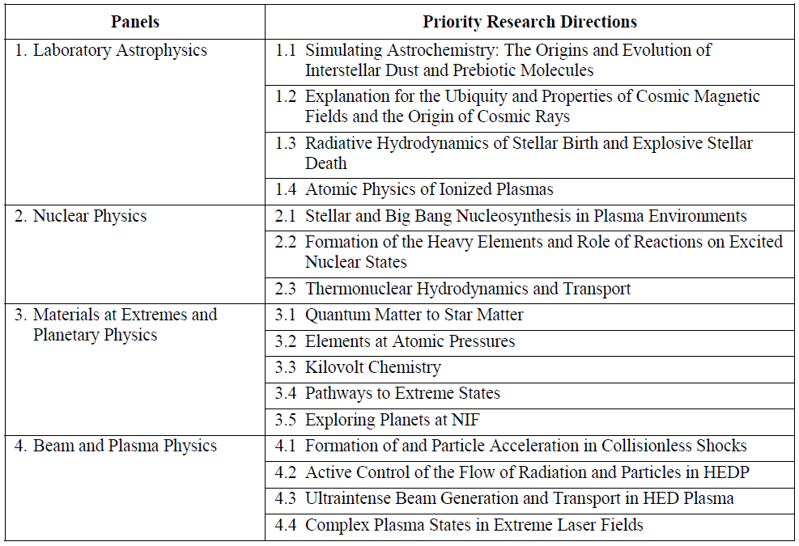
Sixteen Priority Research Directions emerged from Panel Deliberations
Basic Research Directions Workshop on User Science
at the National Ignition Facility

Slide 12
Materials at Extremes and Planetary Physics
CONCLUSIONS
NIF has the potential to open a new dimension
on the study of materials
Novel Quantum Matter to Star Matter
Altogether new forms of matter created on Earth
2. Elements at Atomic Pressures
New dimension to the Periodic Table
3. Kilovolt Chemistry
Novel compounds, both stable and metastable
4. Pathways to Extreme States
Dynamical processes in high-density materials
5. Exploring Exoplanets at NIF
Ground truthing the explosion of astronomical observations
Basic Research Directions Workshop on User Science
at the National Ignition Facility

Slide 13
Materials at Extremes and Planetary Physics
Exploring Exoplanets at NIF
Planets are everywhere. What are they made of?
Testing models of planet formation and evolution.
1/5 of all stars have an ice giant planet.
1/10 of all stars have a earth-like planet.
Need constrained interior models for super-earths, ice giants, gas giants. Up to 10-10³ Mbar, 10³ to 10⁶ K
Did Jupiter form by core accretion or gravitational instability? Is Saturn’s excess luminosity from He rain?
Need high precision H, H-He EOS.
Origin of the Moon and core formation?
Need physics of giant impacts; melting & vaporization; mixing & phase separation
Notes:
Figures: Josh Winn et al. 2011 ApJ Letter, Dave Crawford LPSC Abstract 2011.

Slide 14
Materials at Extremes and Planetary Physics
Exploring Exoplanets at NIF
Discipline Specific Challenge
NIF enabled Innovation
Interior composition, structure and evolution of planets within and outside the solar system?
The physics of planetary impacts and their role in shaping planets?
The formation and diversity of planetary systems; pathways to habitable planets?
Tailored high-precision compression paths: achieve interior conditions of gas and ice giants and super-earths
Mapping of states achieved during impacts and in interiors
Large volume (cm-scale) experiments (heterogeneity, mixing, separation)
Research Directions
Outcome and Potential Impact
Origin of giant planets
Anomalous luminosity of Saturn
Fundamental properties of the Earth: Origin of the moon, core formation
Nature of exoplanets
Change in properties of matter from planets to brown dwarfs to stars
High precision (2%) EOS measurements: H, H-He mixtures and phase separation
Crystal structures and bonding through x-ray diffraction and spectroscopy
Global/multiphase P-V-T EOS models of gases, ices, silicates, iron-alloys
Multiphase hydrodynamics: dynamics of phase mixing and separation
Notes:
Asteroid hazard comments:
need for x-ray impulse loading of realistic asteroid materials to understand deflection by nuclear explosions (NRC report 2010)
2% precision on H EOS a vague memory of a Stevenson talk on what it takes to resolve a ~10Mearth core in Jupiter.

Slide 15
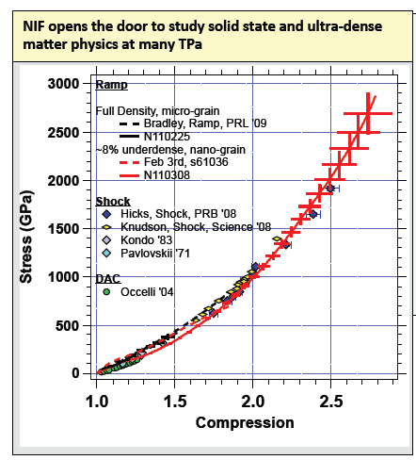
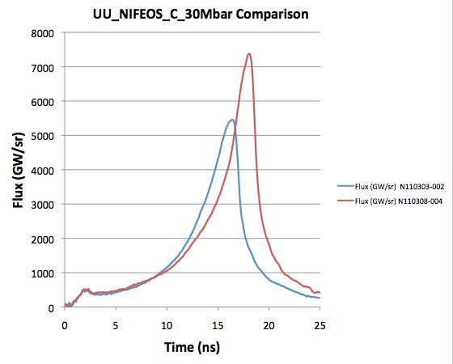
Initial (unprecedented, exciting) data are just the beginning
Carbon compression to ~ 30 Mbar
Tantalum compression to 10’s of Mbar
2nd shot
1st shot
(UC Berkeley, Princeton, LLNL, et al.)

Slide 16
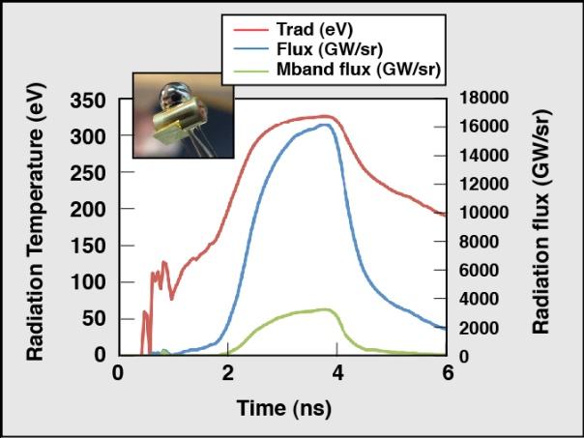
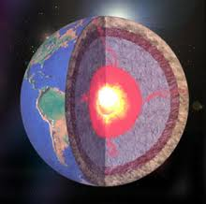
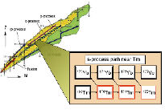
User teams aligned with the priority research directions have already taken data at NIF
Laboratory Astrophysics
Materials and Planetary Physics
Nuclear Physics
Effect of radiation on supernova hydrodynamics
C/Fe equation of state
Nucleosynthesis and the s-process
University of Michigan
UC Berkeley; Princeton University
LLNL; LANL; Ohio University

Slide 17
Governance Models and User Experience were an Important Consideration
Three principles underlie our recommendations:
Make science on NIF successful on long-term timescales
Build a sense of scientific community among NIF users
Utilize best practices and lessons learned from relevant facilities at NIF
(But, don’t tell LLNL and NIF how to do their jobs)
Basic Research Directions Workshop on User Science
at the National Ignition Facility

Slide 18
Recommendations spanned three principal topics
Policy and Governance
-Develop clearly defined user access policy
-Foster independent advisory bodies
-Address stewardship considerations
Facility Operations
-Address/be realistic about NIF capacity for user science
-Provide access to target fabrication and simulation/design support
-Reward and provide resources to NIF staff for supporting users
Outreach and Education
-Educate the community/Communicate the excitement of NIF science
-Establish users’ group
-Grow/foster intellectual centers beyond LLNL
-Create opportunities for young scientists
First NIF User Meeting last week
Basic Research Directions Workshop on User Science
at the National Ignition Facility

Slide 19
Capability gaps
Lab-Astro Panel
Facility capabilities
Beam delays up to 10 µs
Far off axis (10 cm) laser pointing
Induction coils
X-ray diagnostics
Large FOV (~cm), ~ µm resolution gated imaging
Large aperture, high res spectral x-ray imager
Versatile x-ray scattering
Diverse x-ray spectroscopy
“Optical” diagnostics
Optical interferometry
Faraday rotation
UV Thomson scattering
Nuclear Physics Panel
High resolution charged-particle, neutron and gamma spectrometry techniques at low energies
Capsule designs tailored to mimic thermonuclear reaction plasma environments in stellar and big bang nucleosynthesis
Capsule designs tailored to mimic neutron spectra in Asymptotic Giant Branch and massive stars that drive s process nucleosynthesis
Capabilities to load radioactive elements in capsules
Radiochemical diagnostic capabilities (debris collection) and in-situ counting
On the decadal scale, the opportunity exists to shape the facility and to drive r&d
Basic Research Directions Workshop on User Science
at the National Ignition Facility

Slide 20
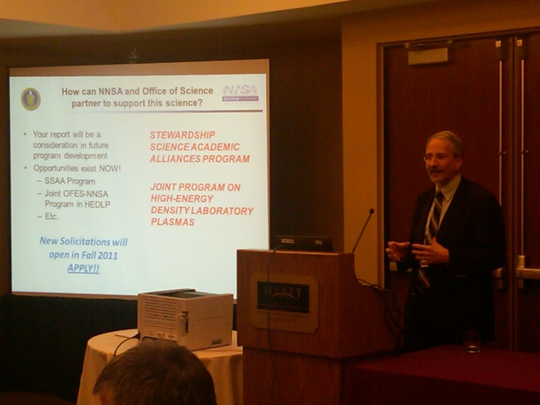
NIF Science 2020
“NIF Science” is more than just HED science
The broader community wants to engage
The time to seize the opportunity is now
Exciting possibilities AND development required
Partnering between SC and NNSA is essential for realizing the full potential of NIF Science
SC & other facilities provide models and infrastructure for NIF to emulate
Basic Research Directions Workshop on User Science
at the National Ignition Facility

Slide 21
Thank you for your interest!
http://science.energy.gov/~/media/sc-2/pdf/reports/SC-NNSA_BRD_Report_on_NIF_User_Science.pdf
Basic Research Directions Workshop on User Science
at the National Ignition Facility

