Slide 1
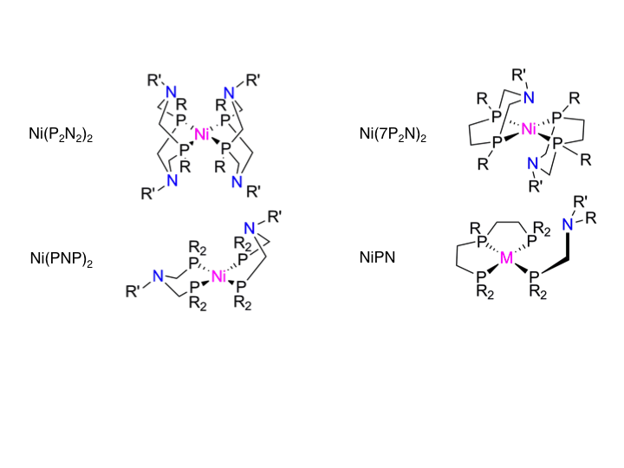
Report of the Committee of Visitors of the
Division of Chemical Sciences, Geosciences,
and Biosciences (CSGB)
to the
Basic Energy Sciences Advisory Committee
Review of FY 2011, 2012, and 2013
April 30 – May 2, 2014
Report presented by Sharon Hammes-Schiffer
University of Illinois at Urbana-Champaign
July 29, 2014

Slide 2
Charge for the COV
Charge: address operations of CSGB Division for FY 2011-2013
For both DOE Lab projects and university projects, assess the efficacy and quality of the processes used to:
  solicit, review, recommend, and document proposal actions
  monitor active projects and programs
Within the boundaries defined by DOE missions and available funding, comment on how the award process has affected:
  breadth and depth of portfolio elements
  national and international standing of portfolio elements
not included: EFRCs, Fuels from Sunlight Energy Innovation Hub,
Office of Science Early Career Program

Slide 3
Three Panels
Panel 1: Fundamental Interactions
Atomic, Molecular, and Optical Sciences
Gas Phase Chemical Physics
Condensed Phase and Interfacial Molecular Science
Computational and Theoretical Chemistry
Panel 2: Photochemistry and Biochemistry
Solar Photochemistry
Photosynthetic Systems
Physical Biosciences
Panel 3: Chemical Transformations
Catalysis Science
Separations and Analysis
Heavy Element Chemistry
Geosciences

Slide 4
Panel Membership: 17 Members
Sharon Hammes-Schiffer, COV Chair, University of Illinois
(BESAC, COV 2008, 2013*)
Panel 1: Fundamental Interactions
Bruce Kay, Panel Lead, PNNL (BESAC, COV 2005)
Heather Lewandowski, JILA/University of Colorado
Giulia Galli, University of Chicago
Gilbert Nathanson, University of Wisconsin
Rigoberto Hernandez, Georgia Tech
Panel 2: Photochemistry and Biochemistry
Jim McCusker, Panel Lead, Michigan State University (COV 2013*)
Greg Scholes, University of Toronto
Claudia Turro, Ohio State University
Lisa Utschig, Argonne National Lab
Joan Broderick, Montana State University
*COV 2013 evaluated EFRCs and JCAP Hub, not CSGB COV

Slide 5
Panel Membership and Process
Panel 3: Chemical Transformations
Nick Winograd, Panel Lead, Penn State University (COV 2005)
Jim Rustad, Corning
Nicholas Delgass, Purdue University
Emily Smith, Iowa State University
James Boncella, LANL
Anne Chaka, PNNL (COV 2005, 2011)
Panel Balance:
funded by BES / not funded by BES: 10 / 7
academic / national lab / industrial: 12 / 4 / 1
Process:
Information provided on CSGB COV website, initial conference call
COV began with overviews of charge, review procedures, and programs
First and second readings of folders, many discussions
Reconvened and finalized findings and recommendations

Slide 6
Major Findings
The COV finds the processes of solicitation, review, documentation, and monitoring of proposals to be outstanding. The reviewing process is comprehensive and thoughtful, and the use of both mail reviews and panel reviews is viewed favorably. The Program Managers are to be commended for their dedication, professionalism, and effectiveness.
The COV judges the breadth and depth of the portfolio elements, as well as the quality of the science and principal investigators, to be excellent. The Program Managers have successfully balanced the mission-oriented nature of the DOE with the flexibility required for high-quality scientific research. The portfolios include many senior scientists who are highly respected at the international level, as well as more junior scientists with promising career trajectories.

Slide 7
Major Findings (Cont.)
The practice of encouraging preliminary statements of potential research projects, that is, white papers, with feedback by the Program Managers is viewed favorably. This practice allows helpful, rapid communication between the Program Manager and the potential principal investigator prior to submission of a full proposal. Such feedback discourages scientists from spending time preparing proposals that are not within the programmatic scope and provides guidance as to how scientists can refine their proposals to be more suitable for the BES mission.
The COV is pleased that the PAMS has been initiated, although the full implementation is not yet complete. The full implementation will provide useful quantitative information about demographics and review procedures.

Slide 8
Major Recommendations
The COV strongly recommends a substantial increase in the funding provided to Program Officers to travel to national and international conferences, as well as to visit the laboratories of researchers in their programs. Attending conferences will enable the Program Managers to identify cutting-edge areas of research and promising researchers and to transmit the BES program message to a broader audience. Visiting the laboratories of principal investigators will allow the Program Managers to maintain closer contact with these researchers and to discuss new research directions within their programs. Overall, increased travel is expected to broaden participation in the BES programs and ensure that the research remains at the forefront of the fields.

Slide 9
Major Recommendations (Cont.)
The COV recommends the continued use of white papers as a mechanism for Program Managers to interact with potential principal investigators prior to the submission of proposals. This practice allows Program Managers to encourage researchers to submit a full proposal, to modify their research directions to be in accordance with programmatic considerations, or to consider alternative funding options if the topic is not aligned with the BES mission.
Although the development of the PAMS is viewed favorably, the COV recommends that the full implementation of this system be completed as soon as possible to allow analysis of data that are directly relevant to the BES programs. Such data will be critical for determining how the reviewing process could be improved and in which directions participation could be broadened.

Slide 10
Major Recommendations (Cont.)
The COV recommends that BES execute a strategic planning session at the division level to evaluate current directions and identify new opportunities and synergies. This type of strategic planning will facilitate communication and collaboration among the programs and will encourage the Program Managers to develop their portfolios in a consistent and cooperative manner. A clarification of the objectives and vision of the CSGB Division, as well as the individual programs, will also be helpful to potential principal investigators submitting proposals. Strategic planning should be an ongoing exercise at both the team level and the division level and should involve input from the community and principal investigators as well as guidance from external sources such as BESAC reports.

Slide 11
Other Comments and Suggestions
For site reviews of proposals from national laboratories, the reviewers are given clear instructions about the review criteria, but this is not always the case for mail reviews of these proposals. The COV suggests that the mail reviewers be sent clear instructions about the review criteria, such as the emphasis on synergy, for these types of proposals.
The balance of funding between proposals with a single principal investigator and those with multiple principal investigators is of interest to the community. A comparison of the productivity from these two types of grants would be helpful in the evaluation of this balance, although the quantification of productivity and the measurement of synergy in multiple principal investigator grants is challenging.

Slide 12
Other Comments and Suggestions
While the practice of using white papers is highly commended, this practice leads to higher apparent acceptance rates because some proposals are discouraged prior to submission. The documentation of when white papers are used would provide more relevant statistics about acceptance rates. The COV recognizes that the documentation of the details of the white paper process would be burdensome and does not consider such detailed documentation to be necessary.
The COV encourages further documentation of collaborations and interactions between programs. This documentation would enable BES to highlight this positive aspect.

Slide 13
Relation to 2011 COV
2011 COV Recommendations and Suggestion:
Program managers encouraged to attend conferences.
Program managers encouraged to continue practice of considering preliminary proposals with rapid evaluations.
BES encouraged to provide more accessible web sites.
PAMS system is essential and should be developed promptly.*
Response:
BES concurred with the three recommendations and agreed to implement them within budgetary constraints.
Three out of four 2014 COV Recommendations/Suggestion were in the 2011 COV report and have been addressed by BES but continue to be significant issues.
The fourth 2014 COV Recommendation of a strategic planning session at the Division level is new.
*Listed as a Comment and Suggestion rather than a Recommendation

Slide 14
Many Thanks!
Harriet Kung, Associate Director of Science for BES
John Miller, Previous Acting Director of CSGB
Michael Casassa, Acting Director of CSGB
John Hemminger, Chair of BESAC
Outstanding BES Program Managers and Staff!
Diane Marceau
Terrific COV Members!

