Slide 1
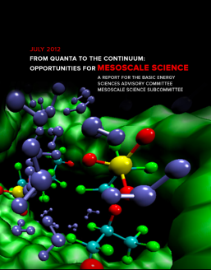
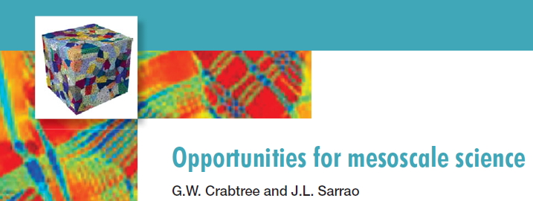

From Quanta to the Continuum:
Opportunities for Mesoscale Science
John Sarrao
George Crabtree
Co-chairs
BESAC subcommittee
on Mesoscale Science
science.energy.gov/bes/news-and-resources/reports/basic-research-needs/
www.meso2012.com/

Slide 2
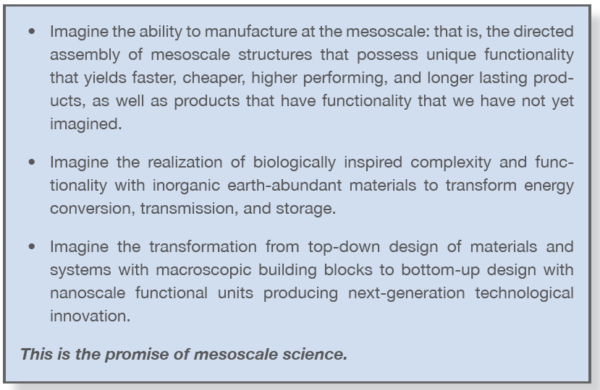
Imagine…

Slide 3
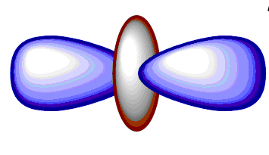
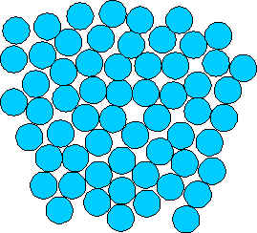

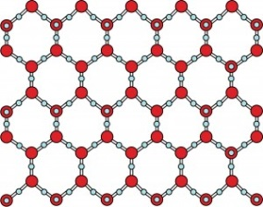
Meso: Beyond atomic, molecular, and nano
meso
classical
quantum
isolated
interacting
collective
simple
perfect
homogeneous
complex
imperfect
heterogeneous
Notes:
Talking points
Covers quantum to coninuum, rise of collective behavior, interacting degrees of freedom, appearance of defects, heterogeneous systems

Slide 4
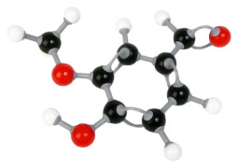
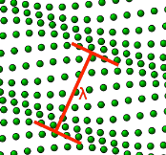
Meso: a Constructionist Drive from the Bottom Up
Constructionist
Reductionist
plants
animals
fossil
fuels
fracture
cracks
built
environment
rocks
geoformations
Hallmarks of mesoscale phenomena →
defect
aggregation
work
hardening
mean
free path
vortices
Cooper pairs
cells
life
sedimentary
rocks
Hieraarchial mesoscale arlchitectures →
structural
defects
electron-phonon
resistivity
superconductivity
membranes
plastics
colloids
magnetics
domains, hysteresis
mechanics
phonons
electronics
insulators - metals
polymers
solutions
chemical
bonds
periodic
lattices
atoms
Notes:
Here are the hierarchical mesoscale architectures, building from isolated atoms to the macroscopic materials we encounter every day
Hallmarks of mesoscale phenomena increase bottom to top, as do the complexity and functionality of mesoscale architectures
Last fifty years and especially the last decade have witnessed a concerted drive to observe at ever smaller length scales and ever shorter time scales
A reductionist drive to understand how the behavior of bulk materials that we experience at the macroscopic, classical and continuous levels are controlled ultimately by the nanoscale organization of atoms.
We are now ready to begin in earnest the journey in the opposite direction: a constructionist drive from the bottom up, using the growing foundation of nanoscale knowledge and tools to manipulate mesoscale architectures to produce qualitatively new kinds of complexity, discover new phenomena, create new functionality and ultimately technology
Meso embodies, inspires and enables constructionist thinking, qualitatively different from traditional reductionist thinking that has dominated science since its inception. Not only do we want to understand materials behavior in terms of underlying causes and architectures, we want to manipulate, configure and design those nano and mesoscale phenomena and architectures to produce new macroscopic behavior and functionality.
The reductionist path down is limited by the existing macroscopic behaviors we know at the top – we follow them down to their nano and atomic roots.
The constructionist path up has no such limitation. It is much wider and broader, rearranging meso and nano phenomena at the bottom in new architectures to produce entirely new phenomena, behavior, functionality and technology.
Meso creates new behavior, targeting features we do not have but wish we had, like strong, lightweight, inexpensive and degradable materials for transportation and construction, or high energy density electricity storage for the grid, or high efficiency conversion of sunlight to electricity or fuel, or electronic materials beyond silicon to extend Moore’s Law.

Slide 5
Six priority research directions enable this vision
Mastering Defect Mesostructure and its Evolution
Regulating Coupled Reactions and Pathway-Dependent Chemical Processes
Optimizing Transport and Response Properties by Design and Control of Mesoscale Structure
Elucidating Non-equilibrium and Many-Body Physics of Electrons
Harnessing Fluctuations, Dynamics and Degradation for Control of Metastable Mesoscale Systems
Directing Assembly of Hierarchical Functional Materials

Slide 6
Why Now?
mesoscale
science
computer modeling
complex materials
nanoscale
knowledge
and tools
A solid foundation in nanoscale science
  intense sources and scanning probes for ultrafast and ultrasmall characterization
  established top down and nascent bottom up synthesis cultures need to be joined
Computer modeling of mesoscale complexity within reach
Complex bio-inspired materials a model for constructionist mesoscale science

Slide 7
Specific actions that will significantly advance mesoscale science
1. Increase investment in small- and intermediate-scale lab instrumentation for mesoscale science;
2. Develop detectors, sample environments, instruments, and end stations for mesoscale research that fully capitalize on the large-scale sources available at national user facilities;
3. Grow the cohort of beam line and facility scientists defining the frontiers of increasingly sophisticated mesoscale measurements at user facilities;
4. Attract and retain the best and brightest graduate students and postdoctoral researchers to be the mesoscale energy scientists of the future; and
5. Stimulate the formation of multi-disciplinary research groups that include theorists and experimentalists and span from discovery science to use-inspired research.

Slide 8
Perspective on Mesoscale Science
A new frontier, where quanta meet the continuum
Six hallmarks of meso phenomena
  atomic granularity; energy quantization; collective behavior;
  interacting degrees of freedom; defects, fluctuations and statistical variation;
  heterogeneity of structure and dynamics
Hierarchy of mesoscale architectures
  based on chemical bonds and periodic lattices
Integration of disciplines and specialties
  especially computation with synthesis and characterization
Multimodal tools for in situ spatial and dynamic resolution
Cross-boundary workforce trained by multiple mentors
Constructionist science from the bottom up
  innovative and complex mesocale architectures
  new horizon of targeted macroscale behavior, functionality and technology
a discovery laboratory for finding new phenomena
a self-assembly foundry for creating new functional systems
a design engine for new technologies

Slide 9
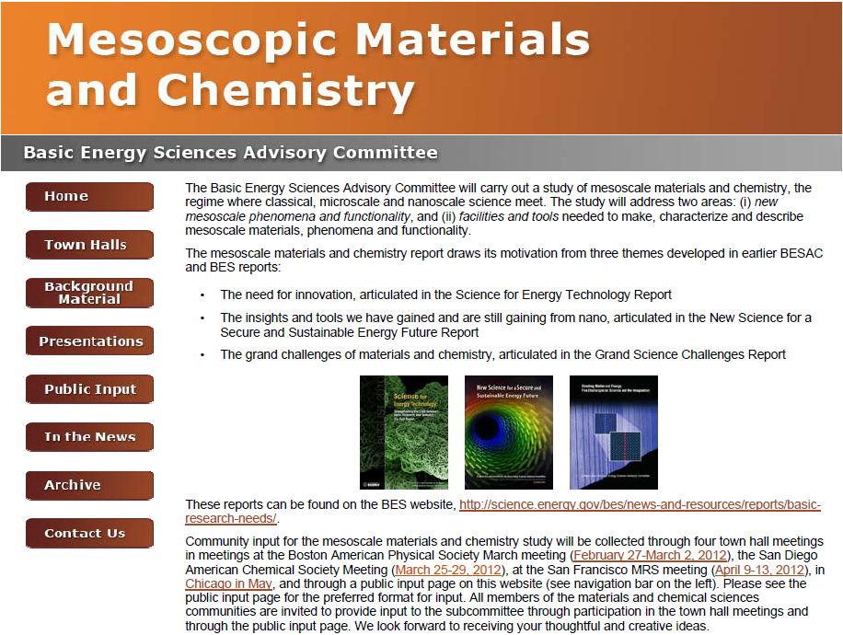

Slide 10
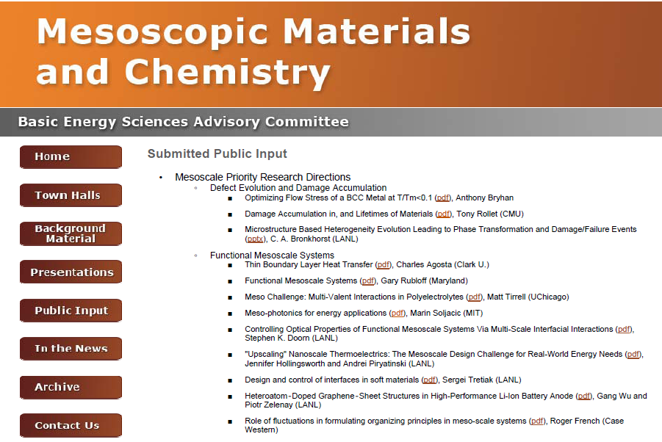

Slide 11
Mesoscale Priority Research Direction
(INSERT TITLE)
Opportunity
Approach
Brief overview of the underlying scientific challenge/current state of understanding
What can be done to address the challenge? What are the key steps along the way?
What new tools and techniques need to be developed to address the challenge?
Meso Challenge
Impact
How will pursuit of the research direction, including the meso opportunity, impact the scientific challenge?
What makes it meso?
We ultimately received > 100 quad charts from the community and they played a central role in shaping our thinking and the report
References:
Contact:

Slide 12
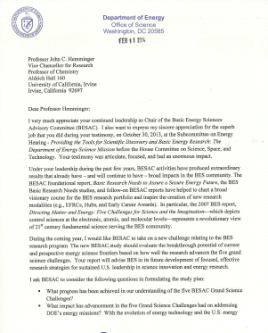
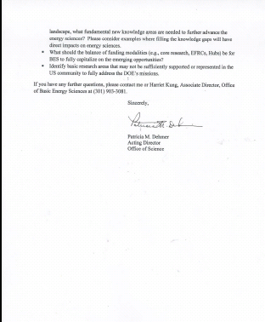
BESAC New Charge on Strategic Planning for BES Research
From: Dr. Pat Dehmer (Acting Director of Office of Science)
The new BESAC study should evaluate the breakthrough potential of current and prospective energy science frontiers based on how well the research advances the five grand science challenges. Your report will advise BES in its future development of focused, effective research strategies for sustained U.S. leadership in science innovation and energy research.
I ask BESAC to consider the following questions in formulating the study plan:
What progress has been achieved in our understanding of the five BESAC Grand Science Challenges?
What impact has advancement in the five Grand Science Challenges had on addressing DOE’s energy missions? With evolving energy technology and U.S. energy landscape, what fundamental new knowledge areas are needed to further advance the energy sciences? Please consider examples where filling the knowledge gaps will have direct impacts on energy sciences.
What should the balance of funding modalities (e.g., core research, EFRCs, Hubs) be for BES to fully capitalize on the emerging opportunities?
Identify research areas that may not be sufficiently supported or represented in the US community to fully address the DOE’s missions.

Slide 13
Paraphrasing Pat/where we need your help
From: Dr. Pat Dehmer (Acting Director of Office of Science)
The new BESAC study should evaluate the breakthrough potential of current and prospective energy science frontiers based on how well the research advances the five grand science challenges. Your report will advise BES in its future development of focused, effective research strategies for sustained U.S. leadership in science innovation and energy research.
I ask BESAC to consider the following questions in formulating the study plan:
What progress has been achieved in our understanding of the five BESAC Grand Science Challenges?
What impact has advancement in the five Grand Science Challenges had on addressing DOE’s energy missions? With evolving energy technology and U.S. energy landscape, what fundamental new knowledge areas are needed to further advance the energy sciences? Please consider examples where filling the knowledge gaps will have direct impacts on energy sciences.
What should the balance of funding modalities (e.g., core research, EFRCs, Hubs) be for BES to fully capitalize on the emerging opportunities?
Identify research areas that may not be sufficiently supported or represented in the US community to fully address the DOE’s missions.
What do we call it?
  Grand Challenges 2.0 seems uninspired
We need to critically assess the current grand challenges and consider new ones
  The right answer is likely 5 +/- a few
We need to honestly answer the question “did the grand challenges make a difference”
  For science
  For BES
  For the Nation
How do we build on our past success?
www.besac-grand-challenge2014.com

Slide 14
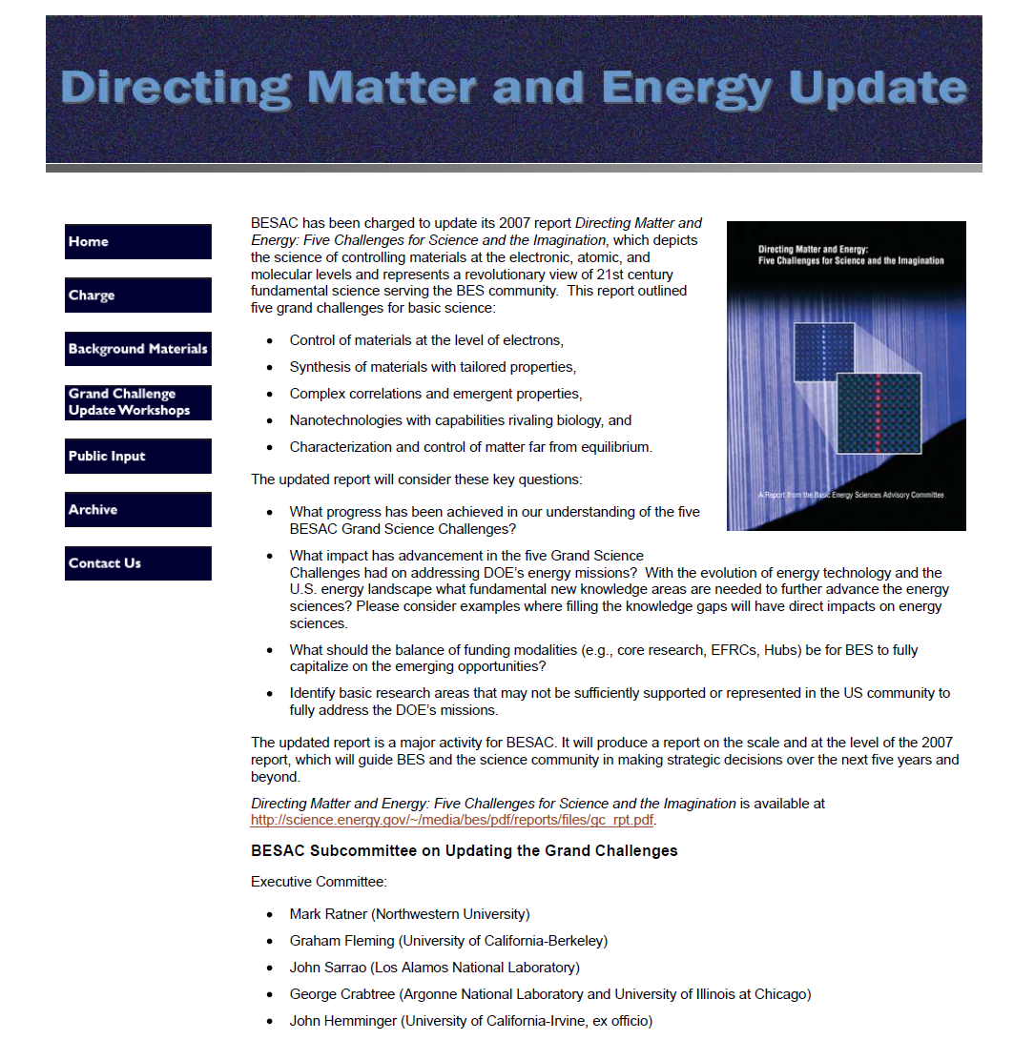
www.besac-grand-challenge2014.com

Slide 15
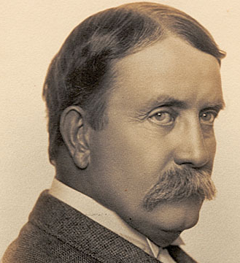
Daniel H. Burnham
Chicago World’s Fair,1893
Make no little plans; they have no magic to stir
men's blood, and probably will not be realized.

Slide 16
Make big plans; aim high in hope and work, remembering that a noble, logical diagram once recorded will not die, but long after we are gone be a living thing, asserting itself with ever-growing insistence.
Daniel H. Burnham
Chicago World’s Fair,1893

