Slide 1

Biological and Environmental Research Advisory Committee
Steven E. Koonin
Under Secretary for Science
September 17, 2010

Slide 2
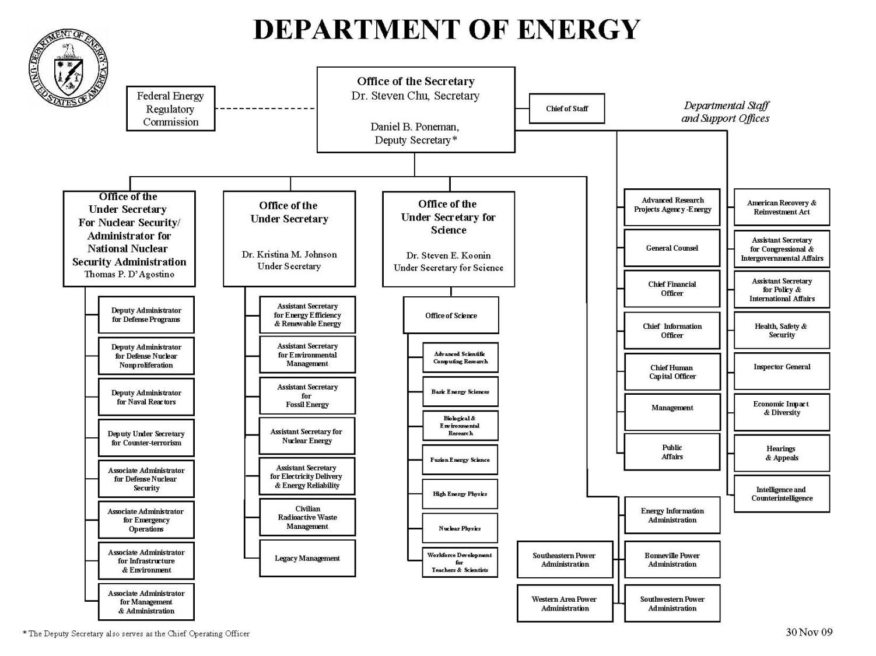
Notes:
S4 roles and responsibilities
How do I find myself in this role and what do I bring to it
- 20 years as basic researcher – NSF support, NP,all five versions of Phys Rev, computation, climate
- 30 PhDs, 200 publications
- Advisory committee system, DOD, realworld problems, technical solutions
- JASON, DOE lab system, NNSA programs
- Provost – many academic cultures, steer research program, hire quality faculty
- After 9 years, time for something else – BP
- Five exciting years – long term research, energy strategy, university research- for profit, global environment, energy problems (1st talk here at FNAL 5 years ago)
S1 appointed, job seemed irresistible –

Slide 3
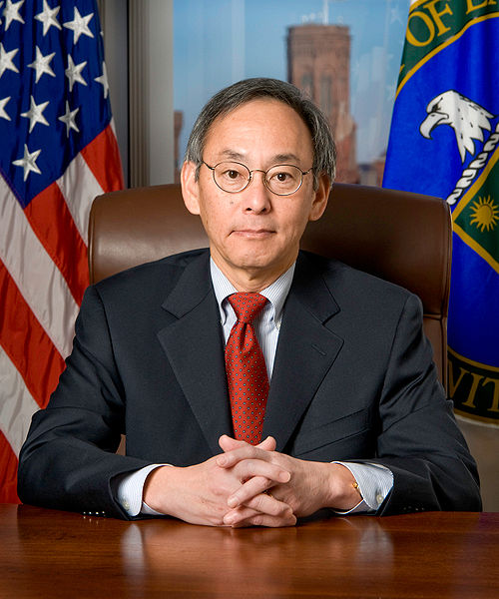
DOE missions
Sustain basic research, discovery and mission driven
Catalyze a transformation of the national/global energy system
Enhance nuclear security
Contribute to US competitiveness and jobs
DOE Secretary, Dr. Steven Chu
Notes:
Discuss framing of the questions from the National Academies presentation

Slide 4
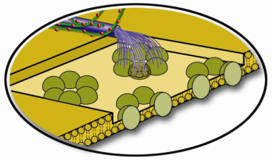
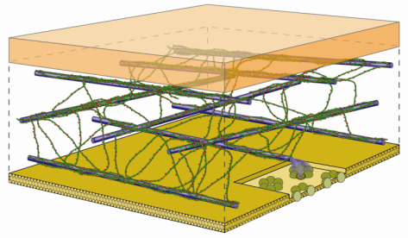


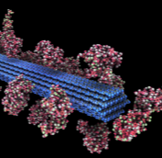
Basic Research
  How do we determine US position in various scientific fields?
  How can we balance resources in basic research between fields close to vs distant from applications?
  How do agencies talk to the public, Congress?
  How can we improve climate science?
Cellulose synthesis
50 nm
Cell wall assembly
Plant material properties
Notes:
As the rest of the world ascends, how do we determine US position in various scientific fields? Who decides, and what processes are used?
How do agencies talk to the world, Congress?
How can we improve climate science?
How can we balance resources in basic research between field that close to applications and those that are not?
Role of discovery science in this era where we have societal challenges such as energy supply, environmental quality, national and economic security;

Slide 5
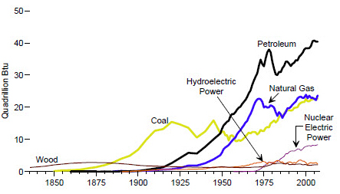
Accelerating Energy Transformation
  Energy security:
  3.5 M bbl/day reduction in crude use
  Greenhouse gas emissions:
  17% reduction by 2020,
  83% by 2050
Annual US Primary Energy Consumption
(Quads)
http://www.eia.doe.gov/aer/ep/ep_frame.html
  Changing the historically decadal timescale?
  S&T engaging society and industry? The best research structures?
  Coupling basic and applied research?
  Formulating/Communicating sensible policy?

Slide 6
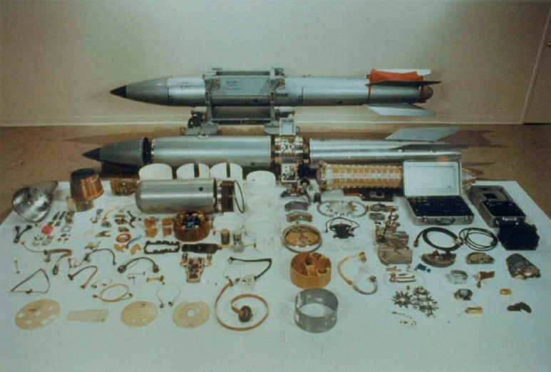
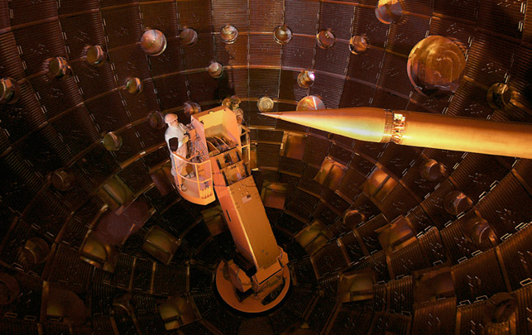
Nuclear Security
  Maintain technical base?
  Keep staff engaged?
  Energy prospects for the National Ignition Facility?
  Exploit simulation capabilities
Notes:
Steward an aging/diminishing stockpile without nuclear testing
Deter/detect proliferation
Secure nuclear materials
How do we maintain the technical base?
How do we keep people stimulated?
What do we do to develop energy prospects for the NIF?

Slide 7
US Competitiveness
  How do we get to a deep understanding of the issues?
  How do we get public dialog/understanding?
  What is the US strategy?
  How do we execute?
  What role do scientists and S&T play?
Trends in US Manufacturing
“The United States led the world’s economies in the 20th century because we led the world in innovation. Today, the competition is keener; the challenge is tougher; and that is why innovation is more important than ever. It is the key to good, new jobs for the 21st century.“ --President Barack Obama, August 5, 2009
Notes:
What is the US strategy? How do we execute it?
How do we get to a real understanding of the issues, a substantive discussion? How do we implement?
What role can physicists [scientists] play? Physics goes beyond a subject matter—it is an attitude and way of thinking. Times are changing, and scientists no longer have the luxury of just focusing on science. Scientists may need to contribute insightful and analytic thinking to more urgent problems in the world…

Slide 8
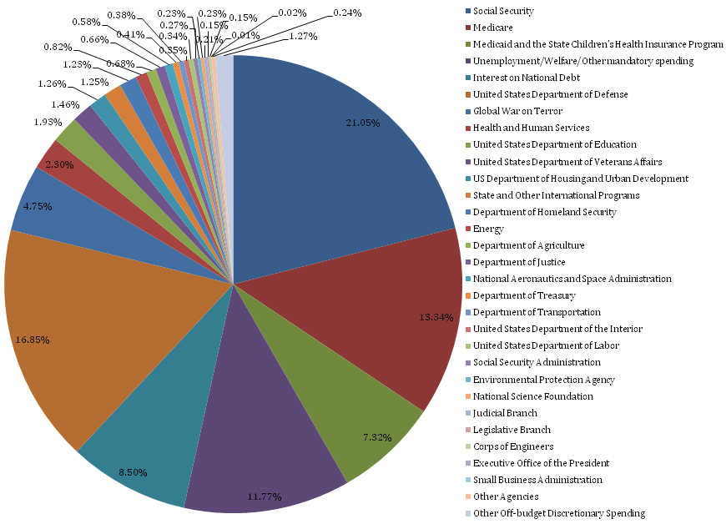
FY09 Federal Spending
DOE
Notes:
DOE is part of discretionary spending – which totals 12% of the US budget. When budget cuts are made, they come out of the discretionary spending. Here, you see .02% of federal funding goes to DOE. All of this is just to make the point that the government does a lot of things.

Slide 9
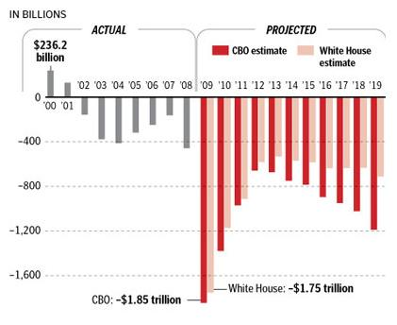
Federal deficit projections
Notes:
And now, we are in especially tough economic times.

Slide 10
Biological and Environmental Research Advisory Committee
Thank you for your hard work and continued dedication to advising the government.
I plan to continue calling on your expertise as we move toward an overall strategic plan.

Slide 11
Questions/Comments?

