Slide 1
DOE Systems Biology Knowledgebase:
A community effort in microbial, plant and metagenomic sciences
BERAC
September 16-17, 2010
Susan K. Gregurick, Ph.D.
Program Manager
Computational Biology & Bioinformatics
Biological and Environmental Research

Slide 2
A Systems Biology Knowledgebase for Energy and the Environment
Knowledgebase: Cyber infrastructure to integrate, search and visualize, in an open environment, experimental data, associated information (metadata), corresponding models and analysis tools.
Enables researchers to i) ask questions about experiments and data, ii) construct new experiments or new models and simulations and iii) to facilitate collaboration with colleagues
Enables DOE program(s) to maintain a digital archive of our research data and the corresponding information and analysis methods.
Unlike other database efforts, the DOE Systems Biology Knowledgebase is focused along DOE Science Objectives in Microbial, Plant and Community sciences.

Slide 3
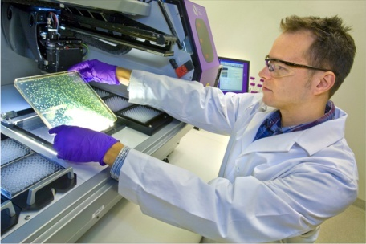

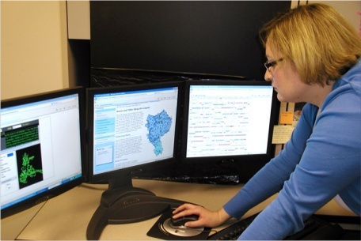
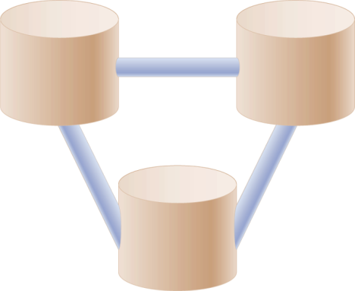
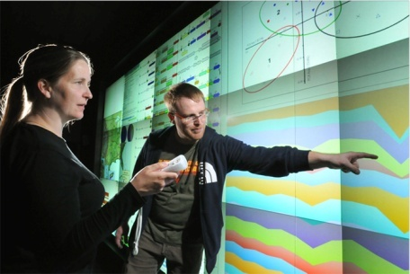
DOE Systems Biology Knowledgebase
Establishing a systems biology modeling framework
Data generators
Open-Access Data and Information Exchange
Flexible user interfaces
Easy data retrieval
Environment for in silico experimentation
Data
users
Seamless Submission and Incorporation of Diverse Data
Standards for data, metadata
Quality control and assurance
Automated data handling
DOE Systems Biology
Knowledgebase
Meta-
data
Community-Wide Stewardship
User, Standards, and Advisory committees
Value-added analysis
Training, tutorials, and support
Data
Software and tool developers
Tools
Open Development of Open-Source Software and Tools
Analysis and visualization
In silico experimentation
Tracking and evaluation of tool use
Notes:
Open-Access Data and Information Exchange
• Access through several flexible interfaces
• Retrieval of experimental data and products of modeling and simulation
• Working environment for testing hypotheses by in silico experimentation
• Provision and sharing of user feedback
Community-Wide Stewardship
• User committee
• Standards committee
• Advisory committee
• Operations
• Development
• Value-added analysis
• Training, tutorials, support staff
Open Development of Open-Source Software and Tools
• Data analysis and visualization tools
• Resources for in silico experimentation
• Modeling and simulation tools
• Customizable tools with layers of functionality
• Tracking and evaluation of tool use
Seamless Submission and Incorporation of Diverse Data
• Standards for data and metadata representation
• Quality control and assurance capabilities
• Automated systems for depositing and updating bulk data
• Tracking and evaluation of data use

Slide 4
The Knowledgebase leverages Genomic Sciences as much as it serves Genomic Sciences
JGI Sequencing
Genome Annotation
KBASE:
Integrate Science Across Activities
Carbon Cycling Processes
Metabolic Modeling
Bioenergy Research
Plant Feedstocks for Bioenergy
Computational Biology
Foundational Research
There is a tremendous wealth of data and information in the Genomic Sciences program. The Knowledgebase is an opportunity to integrate this data and information both within individual activities as well as to integrate together different activities.

Slide 5
The Process to formulate an Implementation Plan for the Knowledgebase
March 2009: DOE Systems Biology Knowledgebase for a New Era in Biology Workshop Report. This was a mission needs workshop establishing community need for a Knowledgebase
July 2009: Recovery Act funds Knowledgebase R & D project to support the research and development of an implementation strategy for the Systems Biology Knowledgebase.
  Community Workshops (80-100 participants each)
    Supercomputing, Nov. 2009
    Plant and Animal Genome XVIII, Jan. 2010
    DOE Genomic Science Grantee Workshop, Feb. 2010
    JGI Users Meeting, March 2010
  Synthesis Workshop (80 participants) June, 2010
  Pilot Projects and Infrastructure-
    Develop bioinformatics software and capabilities for the ASCR Magellan cloud architecture.
    Kandinsky, a cloud cluster as a test bed for storing and analyzing experimental data

Slide 6
Outline for Overall Architecture of Knowledgebase: Science Objectives, Implementation and Computing Architecture
During the Design Process for Kbase, Scientists were asked to:
1). Define a long term measure for science in their area
2). Define 6-8 key objectives that could be met in the near, mid and longer term
3). Prioritize these objectives from High to Moderate to Low
4). Develop a detailed implementation strategy for the high priority objectives
Biological scientists worked with computer scientists, data management and partner scientists to develop a correspondingly detailed computer architecture implementation strategy.
Notes:
Need this transition slide with relative effort

Slide 7
Knowledgebase Science Objectives in Three Key Areas: Microbial Sciences
Long Term Goal: Rapidly reconstruct metabolic and regulatory pathways for 100-1000 microbes with comparative reconstructions at 90% accuracy for growth and phenotypic characteristics.
Year 1 Year 2 Year 3 Year 4 Year 5+
Integrate Data with Genomic Function: Represent experimental data to inferred knowledge about genes and genomes
Reconstruction, Prediction, and Manipulation of Metabolic Networks: Integrate new experimental data and automatically create metabolic reconstructions
Gene Expression Regulatory Networks: Enable automated inference of gene expression and regulatory networks and extend networks to include additional experimental data types

Slide 8
Knowledgebase Science Objectives in Three Key Areas: Plant Sciences
Long Term Goal: Integrate experimental data with key plant genomes, including real-time field data. Associate experimental data with plant phenotype and predict relationship between phenotype to genotype to environment
Year 1 Year 2 Year 3 Year 4 Year 5+
Integrate experimental data with plant genomic sequences: Integrate key types of ‘omics data and associated quality and metadata to DOE priority plant genomes, including integration of field data.
Assemble Regulatory ‘Omics Data: For target plant species enable analysis, comparisons and modeling
Semi-automated inference and simulation of plant metabolic and regulatory networks

Slide 9
Knowledgebase Science Objectives in Three Key Areas: Microbial Community Sciences (Integrated Meta ‘Omics)
Long Term Goal: Integrate experimental ‘omics data with reference metagenomics sample sequences. Develop capabilities for metabolic reconstructions and modeling in natural microbial communities.
Year 1 Year 2 Year 3 Year 4 Year 5+
Understand microbial diversity and poorly characterized genes: Link physiological and metabolic data sets to metagenome sequences
Enable modeling of metabolic processes within a microbial community
From partial single microbial genome found within microbial communities, predict isolated or community growth

Slide 10
Knowledgebase Implementation Timeline
Year 1 Year 2 Year 3 Year 4 Year 5+
Construct repository for experimental microbial data
Develop on-the-fly data analysis capabilities data
Develop workflows
Comparative data and analysis methods
Analysis and programs repository
Develop methods for grown simulations
Extend data integration for plant phenotypes
Develop for metabolic and regulatory modeling of plants
Integrate field data into Kbase (with iPlant)
Develop reference metagenomic data sets repository
Extend repository for imaging and spectroscopic data
Extend phylogenetic analysis methods for metagenomes
Develop new methods for metabolic modeling of microbial communities

Slide 11
Critical Partnerships:
Joint Genome Institute: DOE’s premier high throughput sequencing user facility for Energy and the Environment.
Advanced Scientific Computing Research: DOE’s office of computing research places a high priority on computing at the exascale.
National Center for Biotechnology Information: The major repository of primary sequence and related ‘omics and biomedical data.
NSF-funded iPlant Collaborative (iPlant): A 5-year, $50 million project driven by the needs of the plant science research community.
Discussion of involvement also includes NCI, Google and Amazon
Notes:
JGI: The Knowledgebase will work with JGI to ensure that analysis tools developed are cross-compatible and that sequencing data and experimental data are shared to support a robust annotation system
NCBI: Work together to share data, cross-reference resources, develop community-supported standards for new types of data, develop and re-use tools for data analysis and data visualization and currently forming a NCBI-Kbase working group.
iPLANT: Work together to: cross-reference and integrate datasets relevant to the understanding of plant and microbial biology, develop standards and semantic technologies and develop inference and analysis tools, including portable software and hardware tools useful for field biologists.

Slide 12
Knowledgebase Architecture
Host and integrate diverse biological data sets
Provide both high performance and scalable computational resources
Support a large user community with tools and services
User Environment
Software Engineering
Core Kbase Services
Operations and Support
Data
Management
Workflow
Services
Federated Kbase Computational
Platform
To meet these requirements, the Kbase must be designed with a highly elastic architecture that enables continual expansion and scaling to accommodate new data, computational platforms and software innovations.

Slide 13
Knowledgebase Architecture Milestones:
(18 month release version 1)
Year 1 Year 2 Year 3 Year 4 Year 5+
Computational
Platform, federated system from Cloud to HPC
(release 2)
Operational Support and Maintenance
Data and Workflow Services, including data access and searching
Core Kbase Services, Application Programming Interface (API) and tools for analysis
User Environment, including linking to community analysis programs
FOA Enabling Methods and Pilots
Notes:
T

Slide 14


Knowledgebase Architecture Overview
A summary of the Kbase Cloud:
User Access through a Kbase Core Front End
Kbase Core creates a Virtual Environment to allow users to work on different problems, seamlessly
Cloud resources support data storage and analysis at many locations, independent of users.
Leverage ASCR Magellan, HPC, NERSC and Amazon EC2 and S3
Kbase Core Front End
User Access and Infrastructure Layer

Slide 15
Description of Existing Pilots funded by Recovery Act
Analysis Tools:
Arkin, LBNL: Develop Microbes-On-Line metabolic modeling interface for analysis and visualization within the Google Framework (Google-line Application for Metabolic Maps (GLAMM)).
Meyer, ANL: Benchmark bioinformatics analysis programs on HPC and Cloud systems.
Markowitz, LBNL/JGI: Develop JGI Metagenomic analysis pipelines for HPC and Cloud systems
Infrastructure Tools:
Gorton, PNNL: Prototyping a Service Oriented Architecture (SOA) for storing and accessing biology data in a Cloud computing environment.
Kleese van Dam, PNNL: Develop semantic technologies to ease,
speed up and improve scientific workflows in systems biology
Notes:
Gorton: (data can be loaded, accessed, updated and downloaded in this environment).

Slide 16
DOE Office of Science FOA DE-FOA-0000143: Computational Biology and Bioinformatic Methods to Enable a Systems Biology Knowledgebase
Total $15 million over three years, funds 11 projects, starting 9/15/2010
Annotation: New methods for computational gene annotation that include integration of data and information into the assignment of gene functions
'Omic Data Integration: New computational methods to integrate multiple data types including (meta)genomic, proteomic, metabolomic, transcriptomic, expression and phenotypic data
Integrated Pathway Reconstructions: Significant improvements in methodologies to couple metabolic and regulatory pathways and including integration of data and information
Whole Cellular Simulations: New methods to model complex cellular processes

Slide 17
Better Interpretation and Design of Future Experiments
Computational Bioinformatics
Systems Biology Experiments
Application Programming Interface (API)
Bioinformatics Tool Development
Data
Processed and Inferred
Knowledgebase Core Infrastructure
Scientific Community

Slide 18
Thank you!
Susan Gregurick
Susan.gregurick@science.doe.gov
http://science.doe.gov/ober

