Slide 1
Open Campus: Accelerating Innovation and Discovery at ARL and Beyond
Wendy Leonard
Open Campus Program Manager

Slide 2
The Army’s Corporate Research Lab
Core Technical Competencies
Ballistics Sciences
Network & Information Sciences
Computational Sciences
Operationalizing Science for Transformational Overmatch
Human Sciences
Protection Sciences
Propulsion Sciences
Materials & Manufacturing Sciences
Foundational research in support of US Army Modernization – Focused on disruptive S&T for the long term: Performing research to answer the hardest S&T questions for future Army capabilities.
Notes:
Materials and Manufacturing Sciences focus on fundamental research to provide superior materials and devices needed to enable lasting strategic land power dominance. The future Army will require materials with unprecedented properties rapidly manufactured, grown, synthesized, and produced cost-effectively to enable highly mobile, information reliant, lethal, and protected Army platforms. This technology enables the Army to execute real-time, point-of-need design and fabrication thereby increasing agility and logistical efficiency from the microscale to the infrastructure scale.
Computational Sciences focus on advancing the fundamentals of predictive simulation sciences, data intensive sciences, computing sciences, and emerging computing architectures to transform the future of complex Army applications. The foundational research in artificial intelligence and machine learning will enable autonomous cross-domain maneuver warfighting concepts with intelligent agents that rapidly learn, adapt, and reason faster than the adversary to fight and win in contested, austere, and congested environments.
Ballistics Sciences focus on gaining a greater understanding and discovery of mechanisms and on generating concepts and emerging technologies that support kinetic lethality. Knowledge and concepts gained will lead to unprecedented enhancements in weapons range, precision, and lethality for the mounted and dismounted Soldier against a spectrum of manned and unmanned ground and aerial combat systems.
Human Sciences focus on identifying, creating, and transitioning scientific discoveries and technological innovations underlying Human Behavior; Human Capabilities Enhancement; and Human-System Integration that are critical to the U.S. Army’s future operational superiority. Foundational research in human agent teaming provides human agent teams with the capability to perform as well as Soldier teams but with greater team resilience, faster, more informed team decision making, and reduced numbers and risk to Soldiers.
Propulsion Sciences focus on gaining a greater fundamental understanding of advanced mobility and maneuver technologies that enable innovative vehicle configurations and subsystems architectures – critical to the future Army’s movement, sustainment, and maneuverability. Foundational research in tactical unit energy independence enables energy-intelligent autonomous squad support systems that lighten the Soldier load, providing a more maneuverable, sustainable, and lethal force and intelligently monitor and distribute power on the move, reducing dismounted Soldiers’ cognitive and physical load.
Network and Information Sciences are focused on gaining a greater understanding of emerging technology opportunities that support intelligent information systems that perform acquisition, analysis, reasoning, decision-making, collaborative communication, and assurance of information and knowledge. Understanding gained through these research efforts will lead to technological developments that make it possible to manage, utilize, and maintain trust in information flows and geospatial situational awareness within the battlespace.
Protection Sciences focus on gaining a greater understanding and discovery of mechanisms and generating concepts and emerging technologies that support protection systems that adapt to evolving threats, and the mechanisms of injury affecting the Warfighter. Foundational research in understanding and manipulating the physics of failure will lead to technologies that enable a broad array of resilient kinetic and non-kinetic protection systems and focuses on precise and accurate knowledge of materials/system failure for protection overmatch.

Slide 3
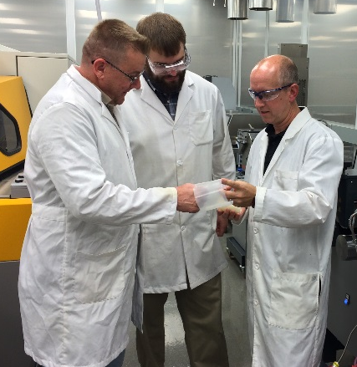
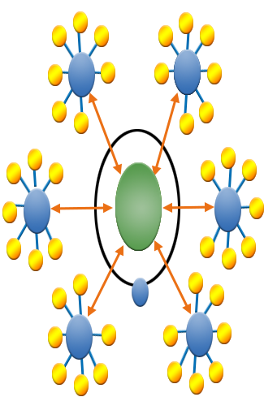
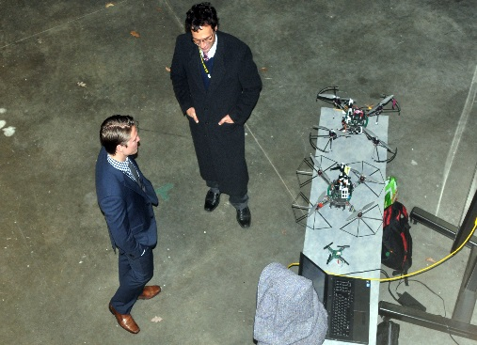
Open Campus Initiative: Reduce Barriers to Collaboration or Risk Being Left Behind
Open areas for researchers and access to existing facilities
Less bureaucracy and paperwork
Collaboration between ARL and external scientists
Virtual research centers
Collaborator presence through EUL
Career path for students and scientists
Novel staff opportunities
Hub and spoke Model
An enhanced defense research environment that fosters discovery and innovation through collaboration on foundational research.
Notes:
Started in FY 14
Just some examples of Open Campus. [Don’t have to cover everything]

Slide 4
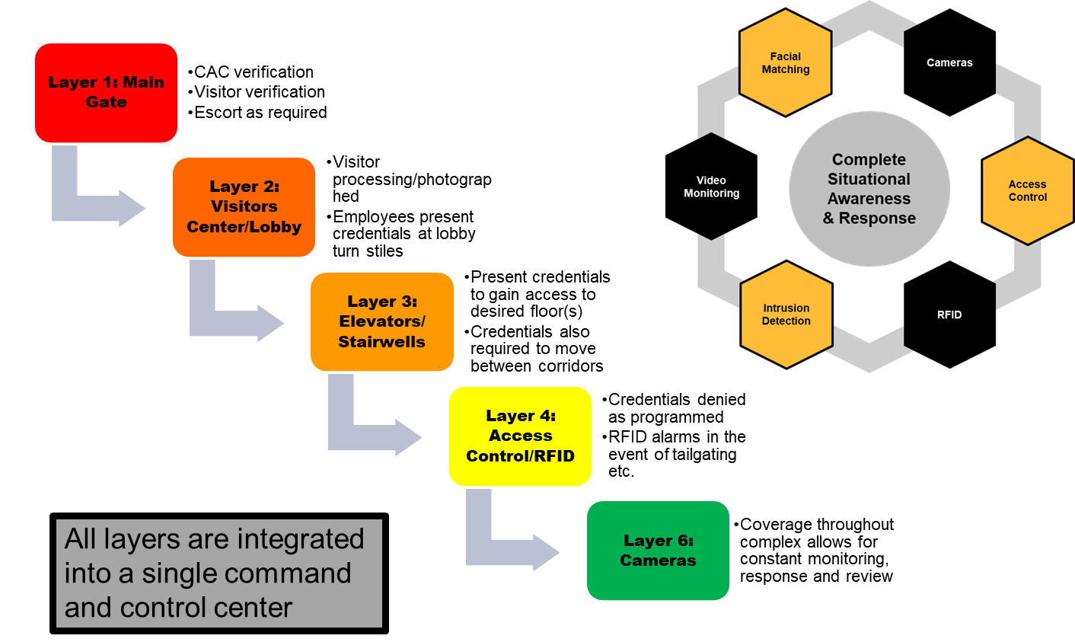
Open campus Security measures

Slide 5
ARL is the Army’s “Face” to the world-wide Academic Community
ARO-London
co-located with
CFEC-ATLANTIC
ARL Central
Chicago, IL
ARL North East
Boston, MA
ARO-Tokyo
co-located with
CFEC-PACIFIC
ARL - Aberdeen Proving Ground
ARL - Adelphi Laboratory Center (Headquarters)
Playa Vista, CA
ARL West
632 Civilians
ARL- White Sands Missile Range
ARL South
Austin, TX
ARL – ARO- RTP, NC
ARO-Brazil
co-located with
CFEC-AMERICAS
VACANT
ARL GLOBAL Network for Foundational Research
ARL Primary Labs Site
Regional Site
International Hub

Slide 6
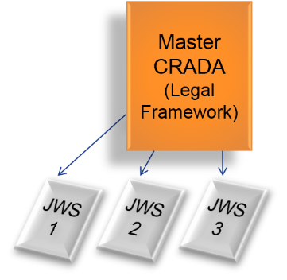
Mechanisms for Collaboration
ARL with Academia, Small Business and Industry:
Cooperative Research and Development Agreement (CRADA)
Patent License Agreement (PLA)
Joint Ownership Agreement (JOA)
Educational Partnership Agreements (EPA)
Small Business Innovation Research (SBIR)
Cooperative Agreements (CA)
Grants
Exchange Staff
Govt
Industry
Faculty
Post Docs
Leverage Facilities
In House Labs
Enhanced Use Lease
Equipment
Share Data
Reports
Joint Pubs
Intellectual Property
Protect IP
License IP
ARL with Foreign Military / Foreign Government:
MOA, MOU
Data Exchange Annex (DEA)
Project Agreements (PA)
Engineer and Scientist Exchange Program (ESEP)
Master CRADA:
Defines legal parameters of joint technical efforts
Addresses protected information, publications, patents, and license rights
Joint Work Statement(s):
Creates the individual technical effort
Multi JWS can be initiated over the life of the CRADA
ARL with US Military / US Government:
Memorandum of Agreement (MOA)
Memorandum of Understanding (MOU)
(Government funding provided to Collaborator : NO YES)

Slide 7
OPEN CAMPUS INITIATIVE
Started in FY14 to link ARL with the global research community; partners and ARL S&Es working side-by-side in research facilities.
Army Benefits as of Sep 30 2019:
_{$43.5M}
_{In-kind research}
_{$118.5M}
in-kind research since Open Campus start
₁₈₁
_{Active CRADAs}
₈₂
_{CRADAs with Academia}
₉₉
_{CRADAs with Industry}
₂₅₀₊
_{CRADA projects}
₁₁₂
_{CRADA projects in Negotiation}
_{>800}
_{visiting researchers}
₂₂
_{different nations}
Collaborations focused on Army-specific challenges of mutual importance to all partners
AFC
CCDC
ARL
Academia
Industry
Partners from Army, Industry and Academia engage in research with shared access to people, infrastructure and resources
Soldier (TRADOC)
DASA(R&T)
Expanded S&T Research Ecosystem
ARL Open Campus is “a role model to the broader defense research enterprise”
- Defense Science Board (DSB) Task Force
on Defense Research Enterprise Assessment, January 2017
Notes:
Numbers current as of 10 June 2019

Slide 8
Leveraging Authorities
10 USC Chapter 81 Note - Eliminated the sunset clause for direct hire of candidates possessing an advanced degree authorized in the FY09 NDAA (2% cap) & amended by FY11 NDAA (5% CAP) & scheduled to expire on Dec 31, 2013.
FY16 NDAA, Section 1109 –Intended to shape the workforce in the most cost effective and efficient manner, enhance the scientific quality, and reduce the average unit cost of the workforce. The pilot authorizes the STRLs to (a) use a renewable 6yr term appt authority for S&E hires and changes the way these appointees are counted against full time equivalents (FTEs); (b) gives the STRL director the ability to determine a reduction in pay of reemployed annuitants; and (c) authorizes VERA/VSIP authority to the STRL director. These authorities expire 12/31/23.
FY17 NDAA, Section 211 –Established the Laboratory Quality Enhancement Program (LQEP)
FY17 NDAA, Section 233 - Pilot Program for Enhancement of Research Development Test and Evaluation Centers instills paradigm shifting management opportunities at DoD STRLs
10 USC §2358a - Replaces Sec. 1107 of the FY14 NDAA and has several provisions: (a) direct hire authority for bachelor degree candidates up to 6%; (b) direct hiring authority for veteran candidates up to 3%; (c) direct hire for students up to 10%; (d) Senior Scientific Technical Managers up to 2%; and (e) excluded STRLs from personnel limitations.
10 USC §2363 - Mechanism to Provide Funds to fund the repair or minor military construction of the laboratory infrastructure and equipment
10 USC§2358 - $150 M per year of RDTE dollars can be utilized to fund a MILCON project at a DoD STRL
10 USC §2805(d) – UMMCA Up to $6 M (Laboratory Revitalization) vs $4M
10 USC §2811 – Repair Up to $7.5 M
Notes:
10 USC Chapter 81 Note – NDAA FY12 –DHA for adv degree put into law with 5% cap
SEC. 211. LABORATORY QUALITY ENHANCEMENT PROGRAM.
Invigorated T2 and infrastructure DoD panels with governance
(a) IN GENERAL.—The Secretary of Defense, acting through the Assistant Secretary of Defense for Research and Engineering, shall carry out a program to be known as the ‘‘Laboratory Quality Enhancement Program’’ under which the Secretary shall establish the panels described in subsection (b) and direct such panels
(1) to review and make recommendations to the Secretary with respect to
(A) existing policies and practices affecting the science and technology reinvention laboratories to improve the mission effectiveness of such laboratories; and
(B) new initiatives proposed by the science and technology reinvention laboratories;
(2) to support implementation of current and future initiatives affecting the science and technology reinvention laboratories; and
(3) to conduct assessments or data analysis on such other issues as the Secretary determines to be appropriate.
(b) PANELS.—The panels described in this subsection are:
(1) A panel on personnel, workforce development, and talent management.
(2) A panel on facilities, equipment, and infrastructure.
(3) A panel on research strategy, technology transfer, and industry and university partnerships.
(4) A panel on governance and oversight processes.
(c) COMPOSITION OF PANELS.—(1) Each panel described in paragraphs (1) through (3) of subsection (b) may be composed of subject matter and technical management experts from
(A) laboratories and research centers of the Army, Navy, and Air Force;
(B) appropriate Defense Agencies;
(C) the Office of the Assistant Secretary of Defense for Research and Engineering; and
(D) such other entities as the Secretary determines to be appropriate.
(2) The panel described in subsection (b)(4) shall be composed of
(A) the Director of the Army Research Laboratory;
(B) the Director of the Air Force Research Laboratory;
(C) the Director of the Naval Research Laboratory;
(D) the Director of the Engineer Research and Development Center of the Army Corps of Engineers; and
(E) such other members as the Secretary determines to be appropriate.
(d) GOVERNANCE OF PANELS.—(1) The chairperson of each panel shall be selected by its members.
(2) Each panel, in coordination with the Assistant Secretary of Defense for Research and Engineering, shall transmit to the Science and Technology Executive Committee of the Department of Defense such information or findings on topics requiring decision or approval as the panel considers appropriate.
(e) DISCHARGE OF CERTAIN AUTHORITIES TO CONDUCT PERSONNEL DEMONSTRATION PROJECTS.—Subparagraph (C) of section 342(b)(3) of the National Defense Authorization Act for Fiscal Year1995 (Public Law 103–337; 108 Stat. 2721), as added by section 1114(a) of the Floyd D. Spence National Defense Authorization Act for Fiscal Year 2001 (as enacted into law by Public Law 106–398;114 Stat. 1654A–315), is amended by inserting before the period at the end the following: ‘‘through the Assistant Secretary of Defense for Research and Engineering (who shall place an emphasis in the exercise of such authorities on enhancing efficient operations of the laboratory and who may, in exercising such authorities, request administrative support from science and technology reinvention laboratories to review, research, and adjudicate personnel demonstration project proposals)’’.
(f) SCIENCE AND TECHNOLOGY REINVENTION LABORATORY DEFINED.
In this section, the term ‘‘science and technology reinvention laboratory’’ means a science and technology reinvention laboratory designated under section 1105 of the National Defense Authorization Act for Fiscal Year 2010 (Public Law 111–84; 10 U.S.C. 2358 note), as amended.
Summary
This section establishes the Laboratory Quality Enhancement Program (LQEP) under the Assistant Secretary of Defense for Research & Engineering. Four panels are to be established:
Personnel, workforce development, and talent management;
Facilities, equipment, and infrastructure;
Research strategy, technology transfer, and industry and university partnerships; and
Governance and oversight processes.
It also amended FY95 NDAA Section 342(b)(3) to read: “The Secretary shall exercise the authorities granted to the OPM under such section 4703 through the ASD(R&E) who shall place an emphasis in the exercise of such authorities on enhancing efficient operations of the laboratory and who may, in exercising such authorities, request administrative support from STRLs to review, research, and adjudicate personnel demonstration project proposals.”
Status
LQEP panels have been established and demonstration project authority has been transferred to ASD(R&E) from USD(P&R).
SEC. 233. PILOT PROGRAM FOR THE ENHANCEMENT OF THE RESEARCH, DEVELOPMENT, TEST, AND EVALUATION CENTERS OF THE DEPARTMENT OF DEFENSE.
We’ve submitted to the process but haven’t been successful as of yet
(a) PILOT PROGRAM REQUIRED.—
(1) IN GENERAL.—The Secretary of Defense and the secretaries of the military departments shall jointly carry out a pilot program to demonstrate methods for the more effective development of technology and management of functions at eligible centers.
(2) ELIGIBLE CENTERS.—For purposes of the pilot program, the eligible centers are—
(A) the science and technology reinvention laboratories, as specified in section 1105(a) of the National Defense Authorization Act for Fiscal Year 2010 (10 U.S.C. 2358 note);
(B) the test and evaluation centers which are activities specified as part of the Major Range and Test Facility Base in Department of Defense Directive 3200.11; and
(C) the Defense Advanced Research Projects Agency.
(b) SELECTION.—
(1) IN GENERAL.—The secretaries described in subsection (a) shall ensure that participation in the pilot program includes—
(A) the Defense Advanced Research Projects Agency; and
(B) in accordance with paragraph (2)—
(i) five additional eligible centers described in subparagraph (A) of subsection (a)(2) from each of the military departments; and
(ii) five additional eligible centers described in subparagraph (B) of such subsection from each of the military departments.
(2) SELECTION PROCEDURES.—
(A) The head of an eligible center described in subparagraph (A) or (B) of subsection (a)(2) seeking to participate in the pilot program shall submit to the appropriate reviewer an application therefor at such time, in such manner, and containing such information as the appropriate reviewer shall specify.
(B) Not later than 120 days after the date of the enactment of this Act, each appropriate reviewer shall—
(i) evaluate each application received under subparagraph (A); and
(ii) approve or disapprove of the application.
(C) If the head of an eligible center submits an application under subparagraph (A) in accordance with the requirements specified by the appropriate reviewer for purposes of such subparagraph and the appropriate reviewer neither approves nor disapproves such application pursuant to subparagraph (B)(ii) on or before the date that is 120 days after the date of the enactment of this Act, such eligible center shall be considered a participant in the pilot program.
(D) For purposes of this paragraph, the appropriate reviewer is—
(i) in the case of an eligible center described in subparagraph (A) of subsection (a)(2), the Laboratory Quality Enhancement Program; and
(ii) in the case of an eligible center described in subparagraph (B) of such subsection, the Director of the Test Resource Management Center.
(c) PARTICIPATION IN PROGRAM.—
(1) IN GENERAL.—Subject to paragraph (2), the head of each eligible center selected under subsection (b)(1) shall propose and implement alternative and innovative methods of effective management and operations of eligible centers, rapid project delivery, support, experimentation, prototyping, and partnership with universities and private sector entities to—
(A) generate greater value and efficiencies in research and development activities;
(B) enable more efficient and effective operations of supporting activities, such as—
(i) facility management, construction, and repair;
(ii) business operations;
(iii) personnel management policies and practices; and
(iv) intramural and public outreach; and
(C) enable more rapid deployment of warfighter capabilities.
(2) IMPLEMENTATION.—
(A) The head of an eligible center described in subparagraph (A) or (B) of subsection (a)(2) shall implement each method proposed under paragraph (1) unless such method is disapproved in writing by the Assistant Secretary concerned within 60 days of receiving a proposal from an eligible center selected under subsection (b)(1) by such Assistant Secretary.
(B) The Director of the Defense Advanced Research Projects Agency shall implement each method proposed under paragraph (1) unless such method is disapproved in writing by the Chief Management Officer within 60 days of receiving a proposal from the Director.
(C) In this paragraph, the term ‘‘Assistant Secretary concerned’’ means—
(i) the Assistant Secretary of the Air Force for Acquisition, with respect to matters concerning the Air Force;
(ii) the Assistant Secretary of the Army for Acquisition, Technology, and Logistics, with respect to matters concerning the Army; and
(iii) the Assistant Secretary of the Navy for Research, Development, and Acquisition, with respect to matters concerning the Navy.
(d) WAIVER AUTHORITY FOR DEMONSTRATION AND IMPLEMENTATION.—
Until the termination of the pilot program under subsection (e), the head of an eligible center selected under subsection (b)(1) may waive any regulation, restriction, requirement, guidance, policy, procedure, or departmental instruction that would affect the implementation of a method proposed under subsection (c)(1), unless such implementation would be prohibited by a provision of a Federal statute or common law.
(e) TERMINATION.—The pilot program shall terminate on September 30, 2022.
(f) REPORT.—
(1) IN GENERAL.—Not later than one year after the date of the enactment of this Act, the Secretary of Defense shall submit to the congressional defense committees a report on the pilot program.
(2) CONTENTS.—The report required by paragraph (1) shall include the following:
(A) Identification of the eligible centers participating in the pilot program.
(B) Identification of the eligible centers whose applications to participate in the pilot program were disapproved under subsection (b), including justifications for such disapprovals.
(C) A description of the methods implemented pursuant to subsection (c).
(D) A description of the methods that were proposed pursuant to paragraph (1) of subsection (c) but disapproved under paragraph (2) of such subsection.
(E) An assessment of how methods implemented pursuant to subsection (c) have contributed to the objectives identified in subparagraphs (A), (B), and (C) of paragraph (1) of such subsection.
SEC. 1122. CODIFICATION AND MODIFICATION OF CERTAIN AUTHORITIES FOR CERTAIN POSITIONS AT DEPARTMENT OF DEFENSE RESEARCH AND ENGINEERING LABORATORIES.
(a) CODIFICATION.—
(1) IN GENERAL.—Chapter 139 of title 10, United States Code, is amended by inserting after section 2358 the following new section:
‘‘§ 2358a. Authorities for certain positions at science and technology reinvention laboratories
‘‘(a) AUTHORITY TO MAKE DIRECT APPOINTMENTS.—
‘‘(1) CANDIDATES FOR SCIENTIFIC AND ENGINEERING POSITIONS AT SCIENCE AND TECHNOLOGY REINVENTION LABORATORIES.—
The director of any Science and Technology Reinvention Laboratory (hereinafter in this section referred to as an ‘STRL’) may appoint qualified candidates possessing a bachelor’s degree to positions described in paragraph (1) of subsection (b) as an employee in a laboratory described in that paragraph without regard to the provisions of subchapter I of chapter 33 of title 5 (other than sections 3303 and 3328 of such title).
‘‘(2) VETERAN CANDIDATES FOR SIMILAR POSITIONS AT RESEARCH AND ENGINEERING FACILITIES.—The director of any STRL may appoint qualified veteran candidates to positions described in paragraph (2) of subsection (b) as an employee at a laboratory, agency, or organization specified in that paragraph without regard to the provisions of subchapter I of chapter 33 of title 5.
‘‘(3) STUDENTS ENROLLED IN SCIENTIFIC AND ENGINEERING PROGRAMS.—The director of any STRL may appoint qualified candidates enrolled in a program of undergraduate or graduate instruction leading to a bachelor’s or an advanced degree in a scientific, technical, engineering or mathematical course of study at an institution of higher education (as that term is defined in sections 101 and 102 of the Higher Education Act of 1965 (20 U.S.C. 1001, 1002)) to positions described in paragraph (3) of subsection (b) as an employee in a laboratory described in that paragraph without regard to the provisions of subchapter I of chapter 33 of title 5 (other than sections 3303 and 3328 of such title).
‘‘(4) NONCOMPETITIVE CONVERSION TO PERMANENT APPOINTMENT.—
With respect to any student appointed by the director of an STRL under paragraph (3) to a temporary or term appointment, upon graduation from the applicable institution of higher education (as defined in such paragraph), the director may noncompetitively convert such student to a permanent appointment within the STRL without regard to the provisions of subchapter of chapter 33 of title 5 (other than sections 3303 and 3328 of such title), provided the student meets all eligibility and Office of Personnel Management qualification requirements for the position.
‘‘(b) COVERED POSITIONS.—
‘‘(1) CANDIDATES FOR SCIENTIFIC AND ENGINEERING POSITIONS.—
The positions described in this paragraph are scientific and engineering positions that may be temporary, term, or permanent in any laboratory designated by section 1105(a) of the National Defense Authorization Act for Fiscal Year 2010 (Public Law 111–84; 10 U.S.C. 2358 note) as a Department of Defense science and technology reinvention laboratory.
‘‘(2) QUALIFIED VETERAN CANDIDATES.—The positions described in this paragraph are scientific, technical, engineering, and mathematics positions, including technicians, in the following:
‘‘(A) Any laboratory referred to in paragraph (1).
‘‘(B) Any other Department of Defense research and engineering agency or organization designated by the Secretary for purposes of subsection (a)(2).
‘‘(3) CANDIDATES ENROLLED IN SCIENTIFIC AND ENGINEERING PROGRAMS.—The positions described in this paragraph are scientific and engineering positions that may be temporary or term in any laboratory designated by section 1105(a) of the National Defense Authorization Act for Fiscal Year 2010 (Public Law 111–84; 10 U.S.C. 2358 note) as a Department of Defense science and technology reinvention laboratory.
‘‘(c) LIMITATION ON NUMBER OF APPOINTMENTS ALLOWABLE IN A CALENDAR YEAR.—The authority under subsection (a) may not, in any calendar year and with respect to any laboratory, agency, or organization described in subsection (b), be exercised with respect to a number of candidates greater than the following:
‘‘(1) In the case of a laboratory described in subsection (b)(1), with respect to appointment authority under subsection (a)(1), the number equal to 6 percent of the total number of scientific and engineering positions in such laboratory that are filled as of the close of the fiscal year last ending before the start of such calendar year.
‘‘(2) In the case of a laboratory, agency, or organization described in subsection (b)(2), with respect to appointment authority under subsection (a)(2), the number equal to 3 percent of the total number of scientific, technical, engineering, mathematics, and technician positions in such laboratory, agency, or organization that are filled as of the close of the fiscal year last ending before the start of such calendar year.
‘‘(3) In the case of a laboratory described in subsection (b)(3), with respect to appointment authority under subsection (a)(3), the number equal to 10 percent of the total number of scientific and engineering positions in such laboratory that are filled as of the close of the fiscal year last ending before the start of such calendar year.
‘‘(d) SENIOR SCIENTIFIC TECHNICAL MANAGERS.—
‘‘(1) ESTABLISHMENT.—There is hereby established in each STRL a category of senior professional scientific and technical positions, the incumbents of which shall be designated as ‘senior scientific technical managers’ and which shall be positions classified above GS–15 of the General Schedule, notwithstanding section 5108(a) of title 5. The primary functions of such positions shall be—
‘‘(A) to engage in research and development in the physical, biological, medical, or engineering sciences, or another field closely related to the mission of such STRL; and
‘‘(B) to carry out technical supervisory responsibilities.
‘‘(2) APPOINTMENTS.—The positions described in paragraph (1) may be filled, and shall be managed, by the director of the STRL involved, under criteria established pursuant to section 342(b) of the National Defense Authorization Act for Fiscal Year 1995 (Public Law 103–337; 10 U.S.C. 2358 note), relating to personnel demonstration projects at laboratories of the Department of Defense, except that the director of the laboratory involved shall determine the number of such positions at such laboratory, not to exceed 2 percent of the number of scientists and engineers employed at such laboratory as of the close of the last fiscal year before the fiscal year in which any appointments subject to that numerical limitation are made.
‘‘(e) EXCLUSION FROM PERSONNEL LIMITATIONS.—
‘‘(1) IN GENERAL.—The director of an STRL shall manage the workforce strength, structure, positions, and compensation of such STRL—
‘‘(A) without regard to any limitation on appointments, positions, or funding with respect to such STRL, subject to subparagraph (B); and
‘‘(B) in a manner consistent with the budget available with respect to such STRL.
‘‘(2) EXCEPTIONS.—Paragraph (1) shall not apply to Senior Executive Service positions (as defined in section 3132(a) of title 5) or scientific and professional positions authorized under section 3104 of such title.
‘‘(f) DEFINITIONS.—In this section:
‘‘(1) The term ‘employee’ has the meaning given that term in section 2105 of title 5.
‘‘(2) The term ‘veteran’ has the meaning given that term in section 101 of title 38.’’.
(2) CLERICAL AMENDMENT.—The table of sections at the beginning of chapter 139 of such title is amended by inserting after the item relating to section 2358 the following new item:
‘‘2358a. Authorities for certain positions at science and technology reinvention laboratories.’’.
REPEAL OF SUPERSEDED SECTION.—Section 1107 of the National Defense Authorization Act for Fiscal Year 2014 (10 U.S.C. 2358 note) is hereby repealed.
Summary
This section replaces Sec. 1107 of the FY14 NDAA and has several provisions: (a) direct hire authority for bachelor degree candidates up to 6%; (b) direct hiring authority for veteran candidates up to 3%; (c) direct hire for students up to 10%; (d) Senior Scientific Technical Managers up to 2%; and (e) excluded STRLs from personnel limitations.
Status
No changes are required for the STRLs to implement this authority, however, with respect to the exclusion from personnel limitations, the answer remains the same as for Sec. 1107, NDAA FY14.
SEC. 2801. MODIFICATION OF CRITERIA FOR TREATMENT OF LABORATORY REVITALIZATION PROJECTS AS MINOR MILITARY CONSTRUCTION PROJECTS.
(a) INCREASE IN THRESHOLD.—Section 2805(d) of title 10, United States Code, is amended by striking ‘‘$4,000,000’’ each place it appears in paragraph (1)(A), (1)(B), and (2) and inserting ‘‘$6,000,000’’.
(b) NOTICE REQUIREMENTS.—Section 2805(d) of such title is amended—
(1) by striking the second sentence of paragraph (2); and
(2) by amending paragraph (3) to read as follows:

Slide 9
Metrics – The Value Proposition
Beneficial to all parties
Type of Payoff | ARL | Partner
Tangible (definable monetary value) | New funded programs Access to unique partner facilities Leveraged partner research
 | Ability to attract private capital Access to senior Government leaders | Funding students, postdocs, staff New equipment, supplies
Intangible (no definable monetary value) | Improved agility to move into new research areas New connections Joint publications Access to broader intellectual base Early access to new partner discoveries
 | New employees Hire more effectively into difficult areas Teaching opportunities for ARL staff | Access to Army problems & priorities ARL Staff as teachers Paths for student employment

Slide 10
Key Takeaways
Revitalization and Leveraging Authorities
Tools to facilitate innovation
Building Partnerships
Finding the right partners
Reducing barriers to establish relationship
Using State &Local Government as well as PIAs to expand your ecosystem
Value Proposition
Not the same value to each but beneficial to all parties

Slide 11
How does someone engage in ARL’s Open Campus?
Explore www.arl.army.mil/opencampus
Review collaboration opportunities and ARL facilities
Start a dialog with ARL researcher or regional lead
If appropriate, develop joint statement of work within CRADA
Open Campus Open House
More Information at www.arl.army.mil
https://www.arl.army.mil/business/
https://www.arl.army.mil/technologyoutreach/
ARL Facilities

